Slide 1
Lecture Notes: RGB and HSV Color Spaces

Slide 2
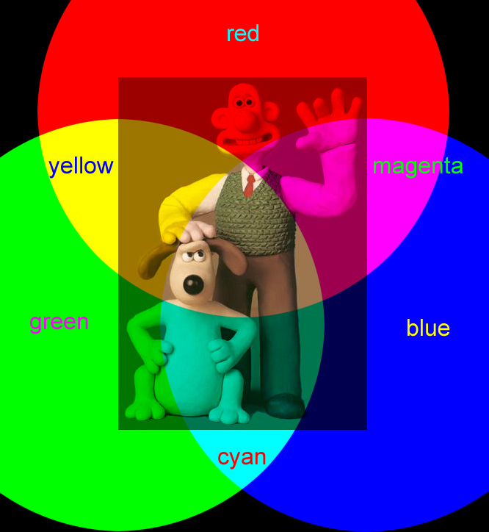
Color Images
Are constructed from three overlaid intensity maps.
Each map represents the intensity of a different “primary” color.
The actual hues of the primaries do not matter as long as they are distinct.
The primaries are 3 vectors (or axes) that form a “basis” of the color space.

Slide 3
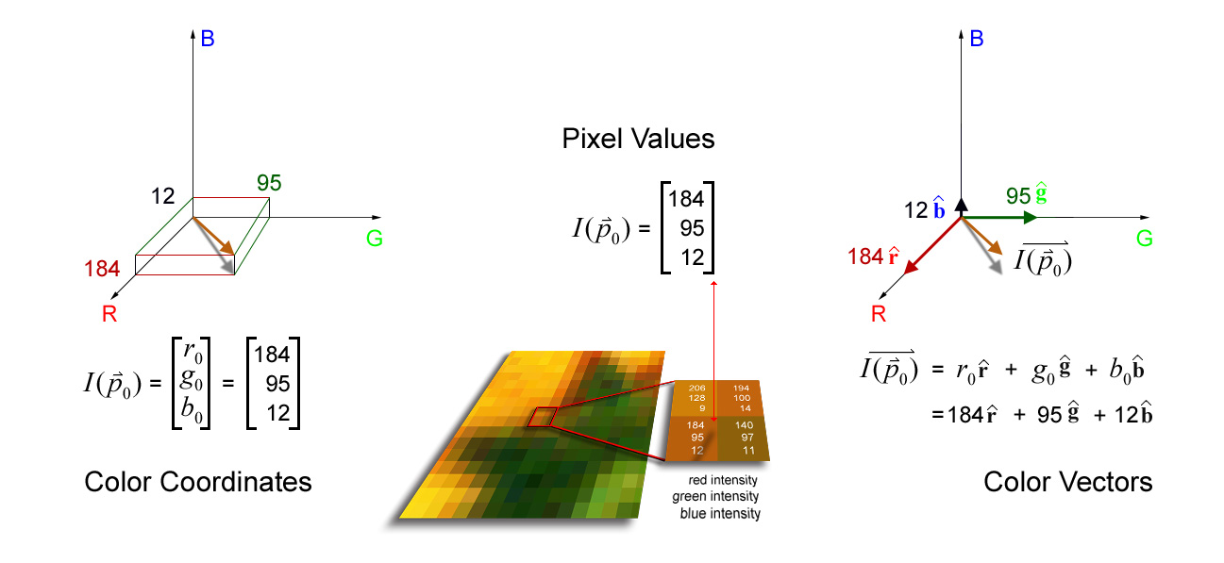
Vector-Valued Pixels
Each color corresponds to a point in a 3D vector space

Slide 4
RGB Color Space
for standard digital images
primary image colors red, green, and blue
correspond to R,G, and B axes in color space.
8-bits of intensity resolution per color
correspond to integers 0 through 255 on axes.
no negative values
color “space” is a cube in the first octant of 3-space.
color space is discrete
256³ possible colors = 16,777,216 elements in cube.

Slide 5
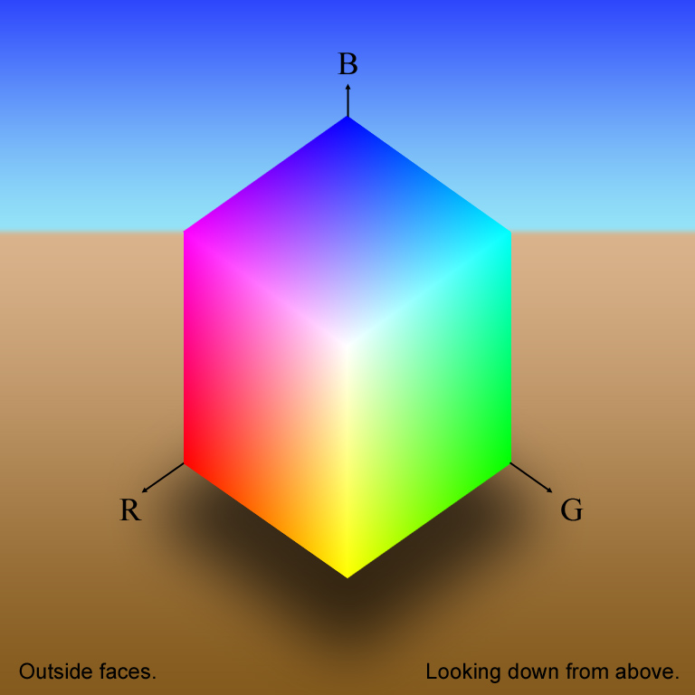

Color Cube: Faces (White-Point View)
The CMY color space is …

Slide 6
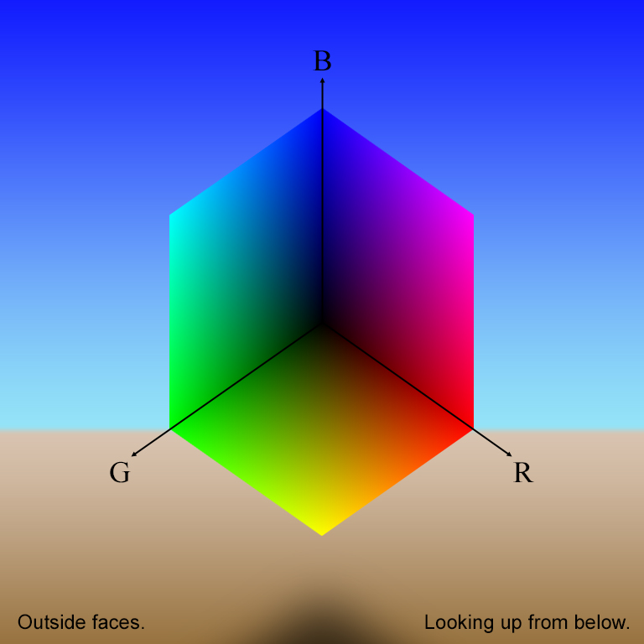
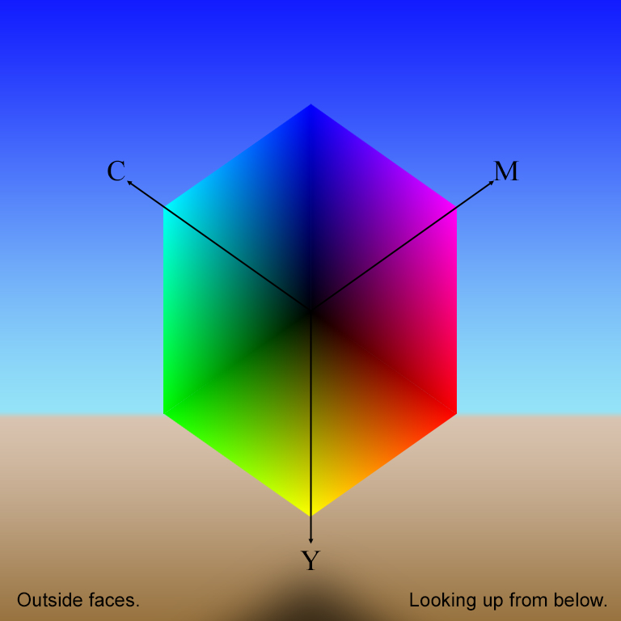
Color Cube: Faces (Black-Point View)

Slide 7
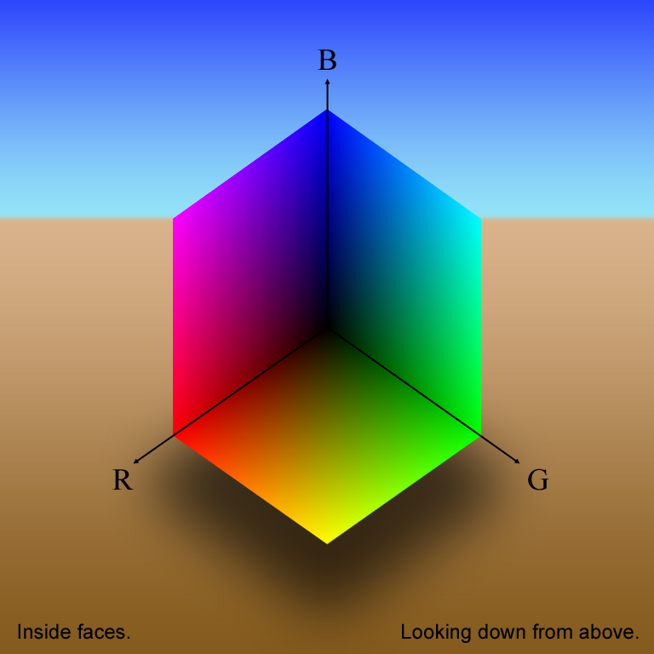
Color Cube: Faces (inner and outer)

Slide 8
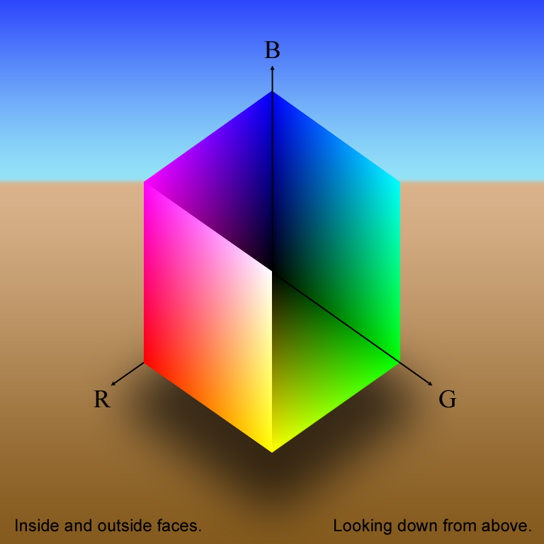
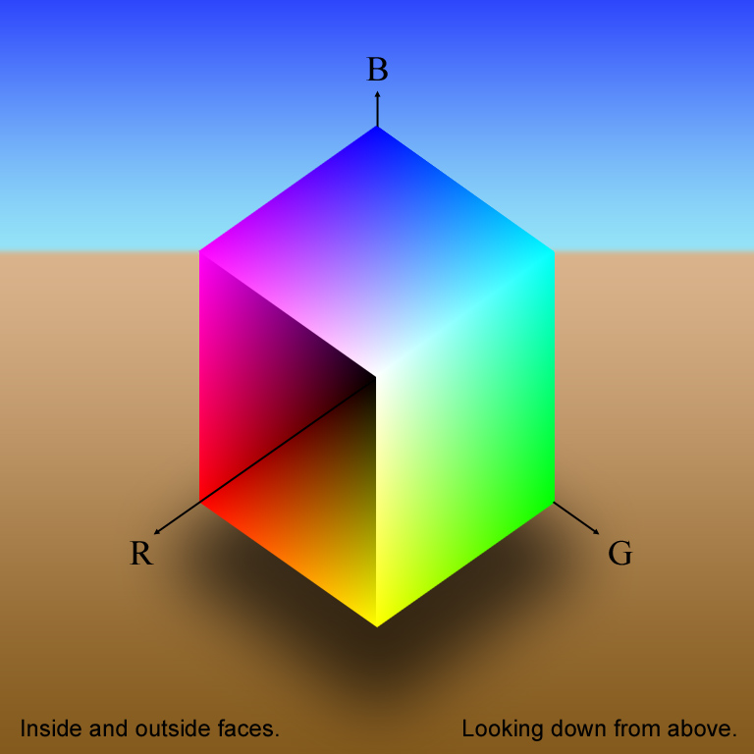
Color Cube: Faces (inner and outer)

Slide 9
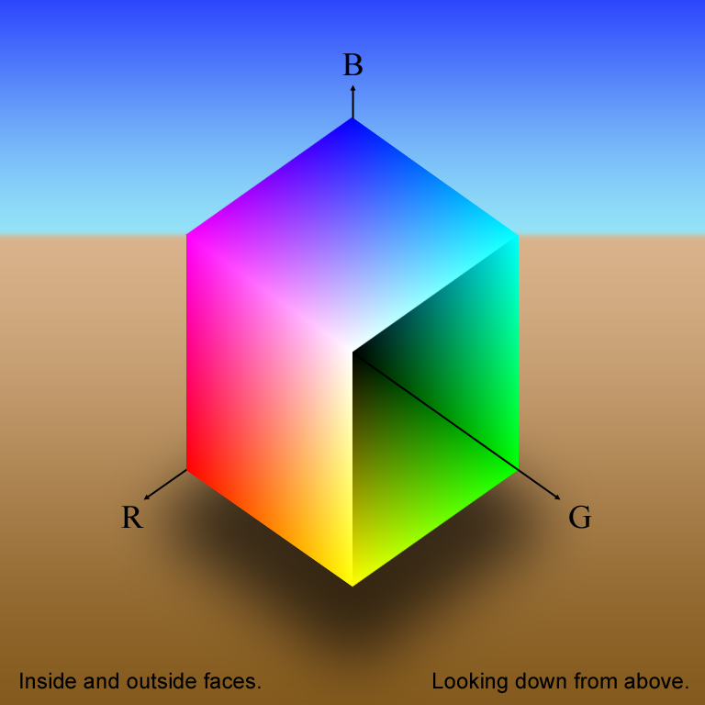
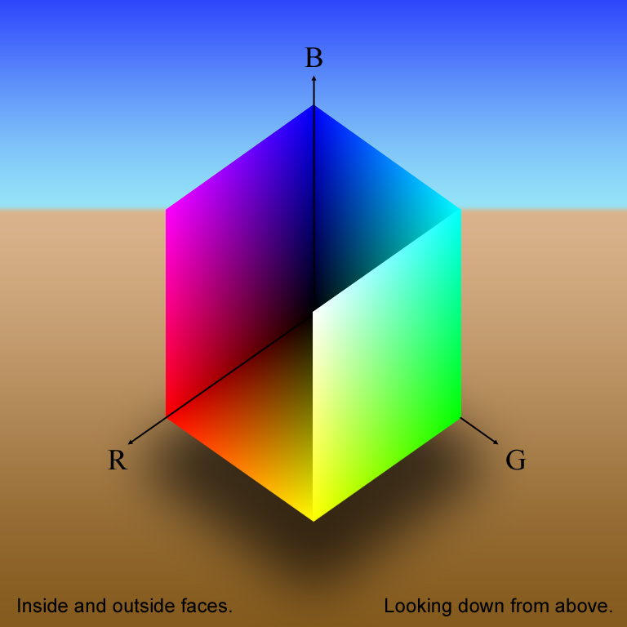
Color Cube: Faces (inner and outer)

Slide 10
Color Cube: Faces (inner and outer)

Slide 11
Color Cube: Faces (inner and outer)

Slide 12
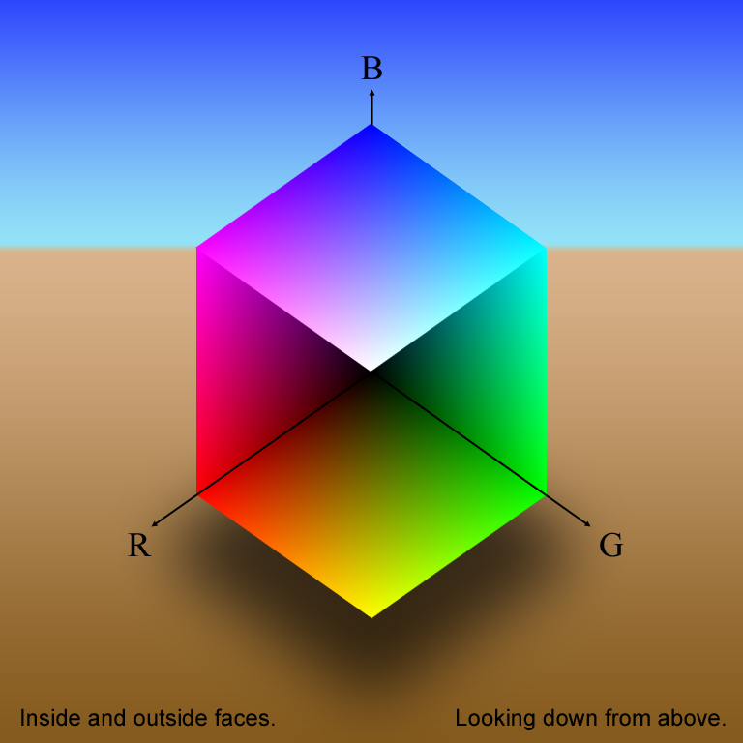
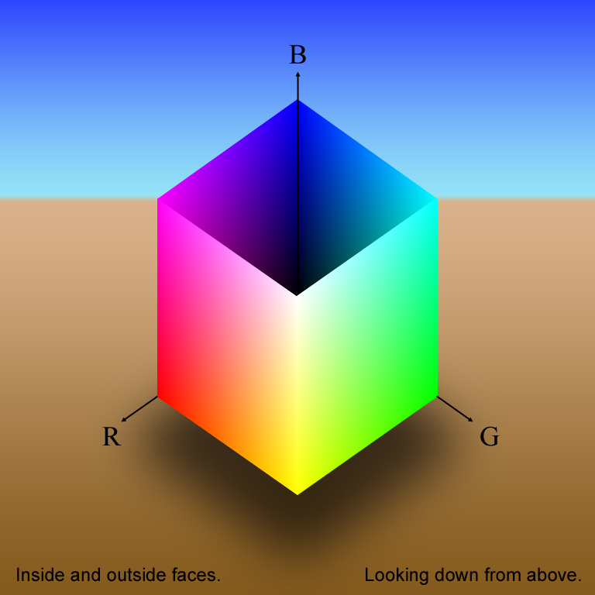
Color Cube: Faces (inner and outer)

Slide 13
Color Cube: Faces (inner and outer)

Slide 14
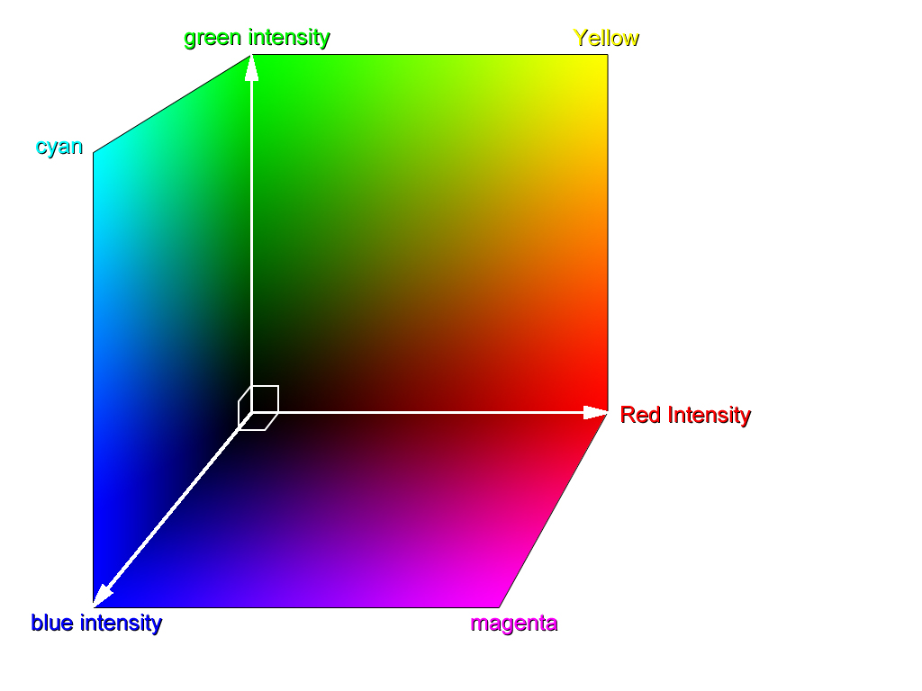
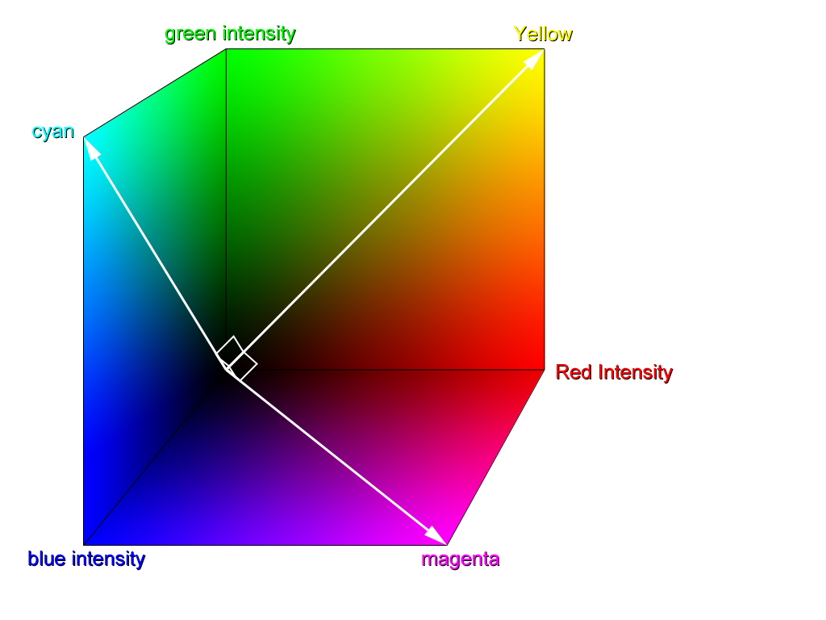
Different Axis Sets in Color Space
RGB axes
CMY axes

Slide 15
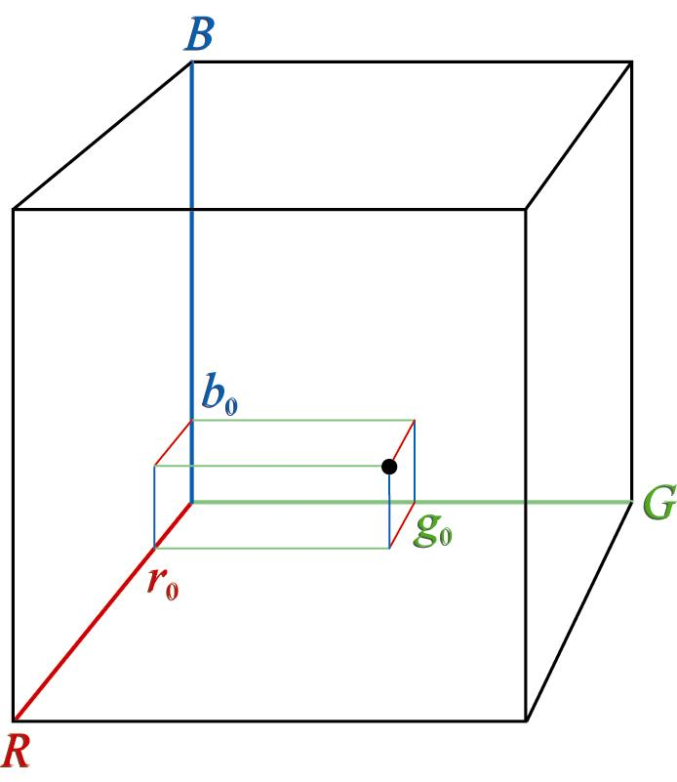
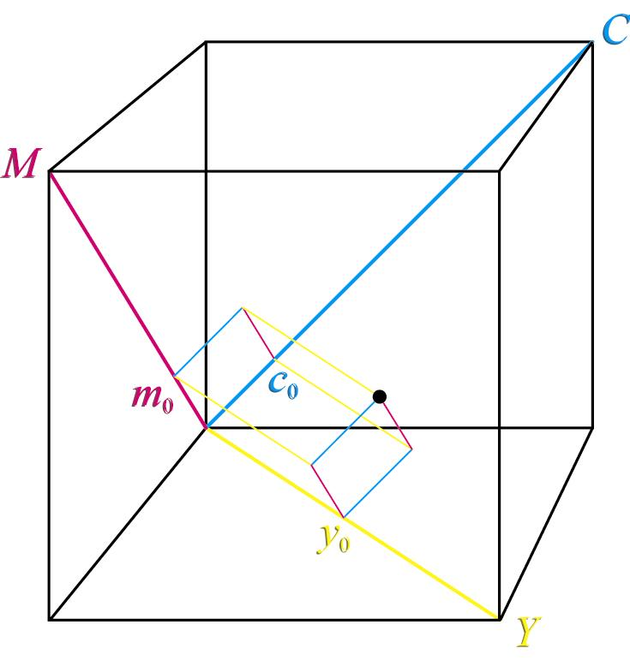
Color With Respect To Different Axes
The same color has different RGB and CMY coordinates.

Slide 16
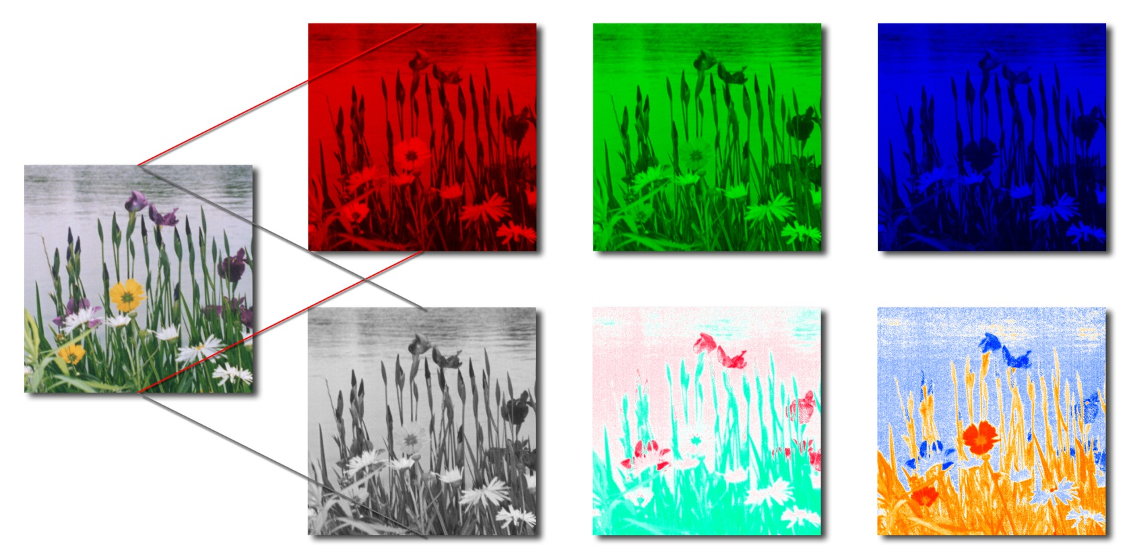
Color Images
are represented by three bands (not uniquely) e.g., R, G, & B or L, a*, & b*.
Red
Green
Blue
R
G
B
Luminance
a*-chroma
b*-chroma
L
a*
b*

Slide 17
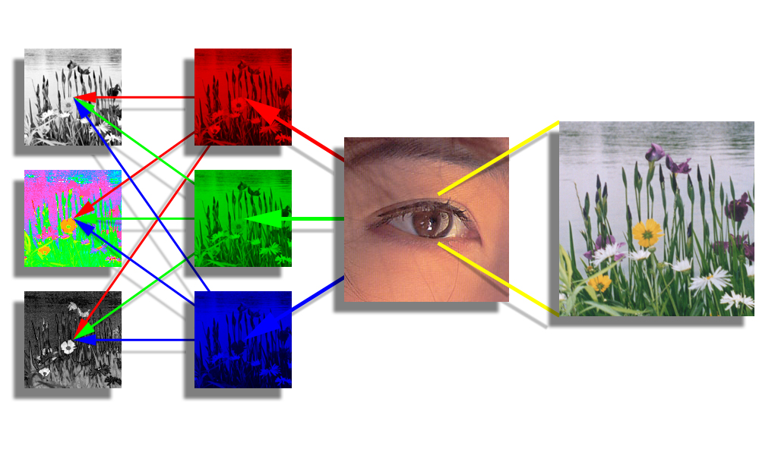
RGB to LHS: A Perceptual Transformation
luminance
The eye has 3 types of photoreceptors:
sensitive to red, green, or blue light.
hue
saturation
The brain transforms RGB into separate brightness and color channels (e.g., LHS).
brain
photo receptors

Slide 18
Color Representations: Color Spaces
RGB is the most familiar color representation because our digital imaging devices use them to encode and to display images. Because they have sensors that are sensitive to red, green, and blue light, cameras transduce an image projected onto its sensor array into a matrix of 3-vectors.
The vectors may be transformed into other representations for processing or analysis. Here we consider one such representation, the HSV colorspace. It is a cylindrical coordinate representation of colors that separates the brightness (value) from the chrominance (hue and saturation).

Slide 19
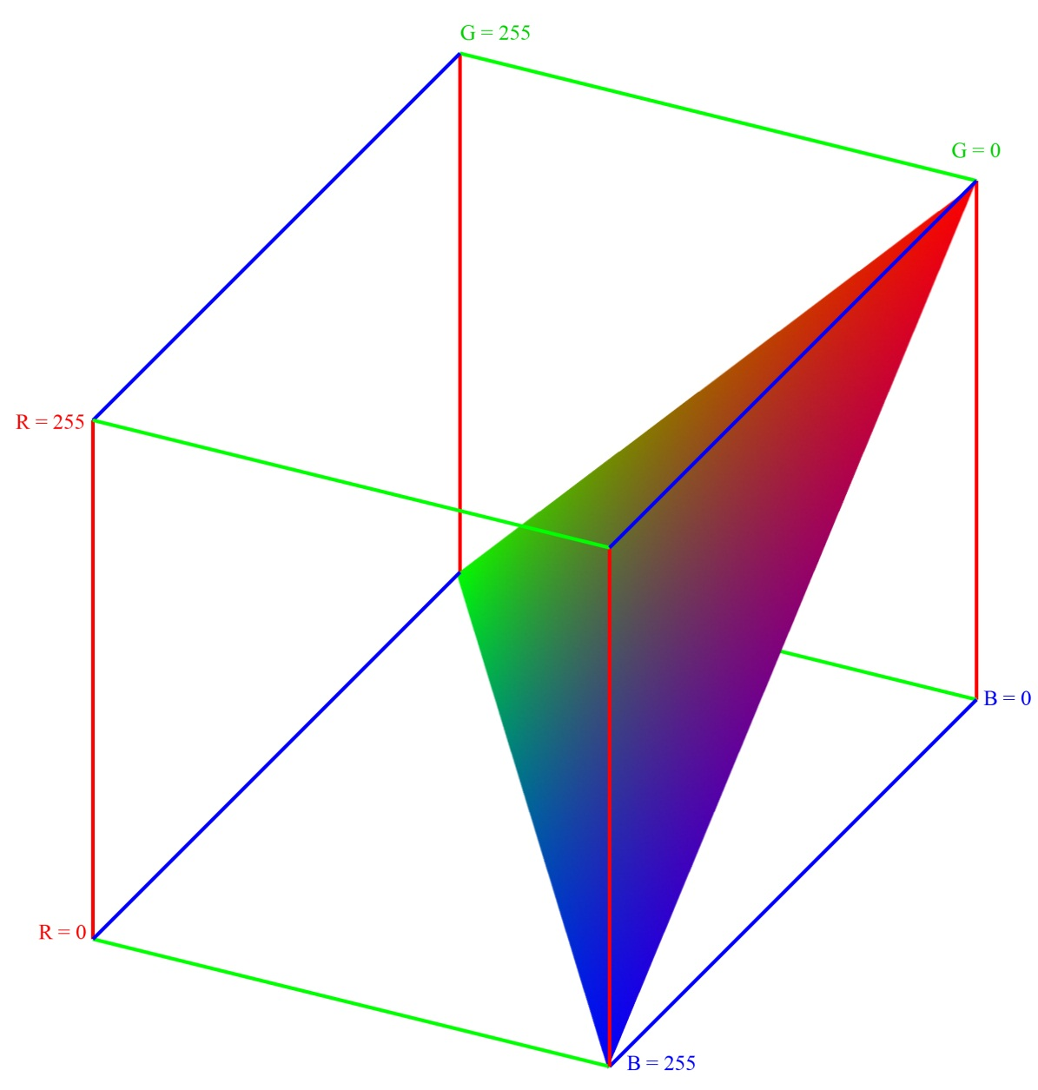
Equivalue Color Triangle
HSV is defined with respect to planes that cut the cube perpendicularly to the gray line – c⋅[1 1 1]^{T} where c ∈ {0,…255}. These are called equivalue planes.
A plane through the colors
forms a triangle inside the color cube if c ≤ 255 or c ≥ 510, or a hexagon if 255 < c < 510. Every color on the planar surface is such that r + g + b = c. Therefore its value is c/3. It is on this equivalue plane that hue and saturation are computed.
c=255, v=85

Slide 20
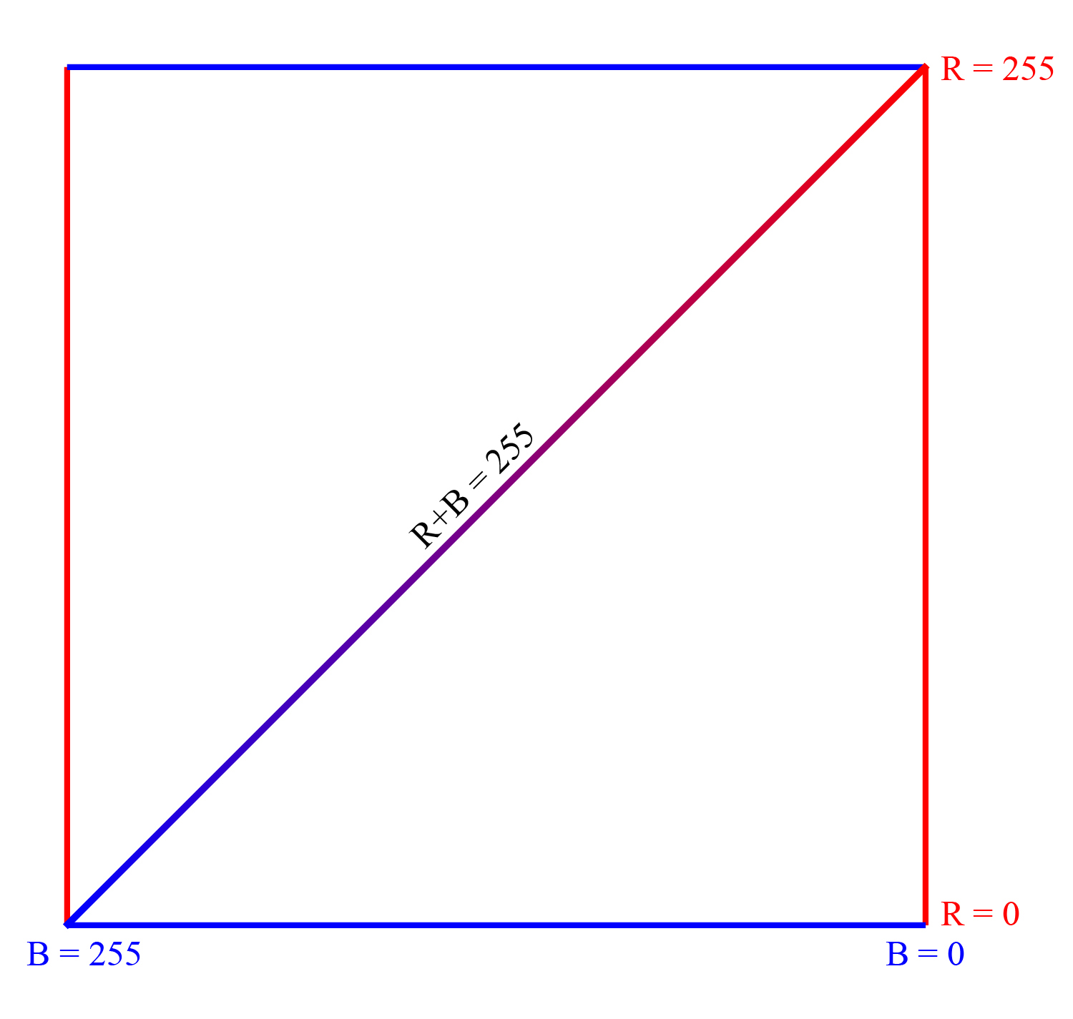
Equivalue Color Triangle
c=255, v=85
On the g = 0 face of the cube the triangle traces the line, r + b = 255.

Slide 21
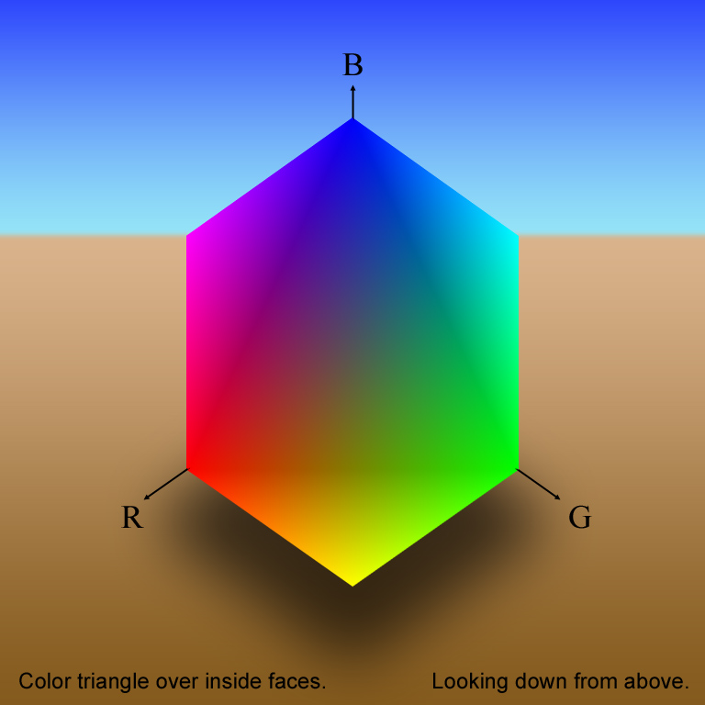
Color Cube: Equivalue Triangle
Notice the dark outline of the triangle. It is not there – not a real feature of the color surface. The planar discontinuities in 3D at the edges of the triangle project to abrupt changes in the color gradient in the 2D image. The change in gradient is a second order effect that is exaggerated by the color-agonist, center-surround edge detectors on the retina. It is an optical illusion.

Slide 22
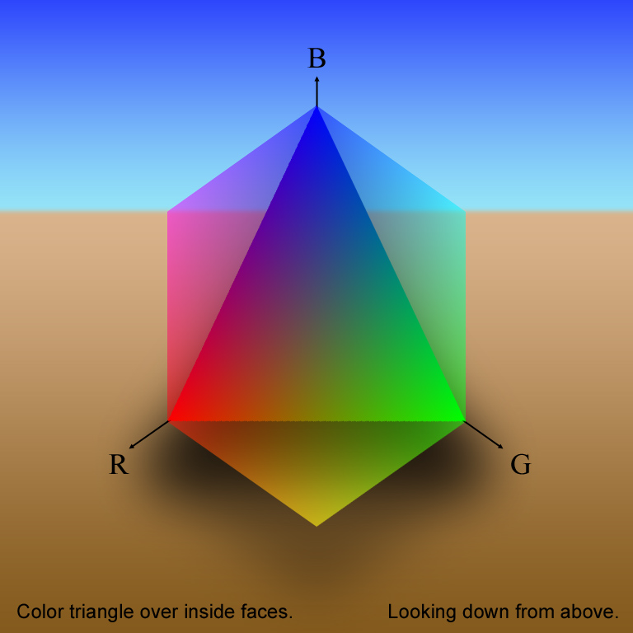
Color Cube: Equivalue Triangle
As the cube is faded out over this and the next 2 slides, the discontinuity diminishes and dark outline disappears.

Slide 23
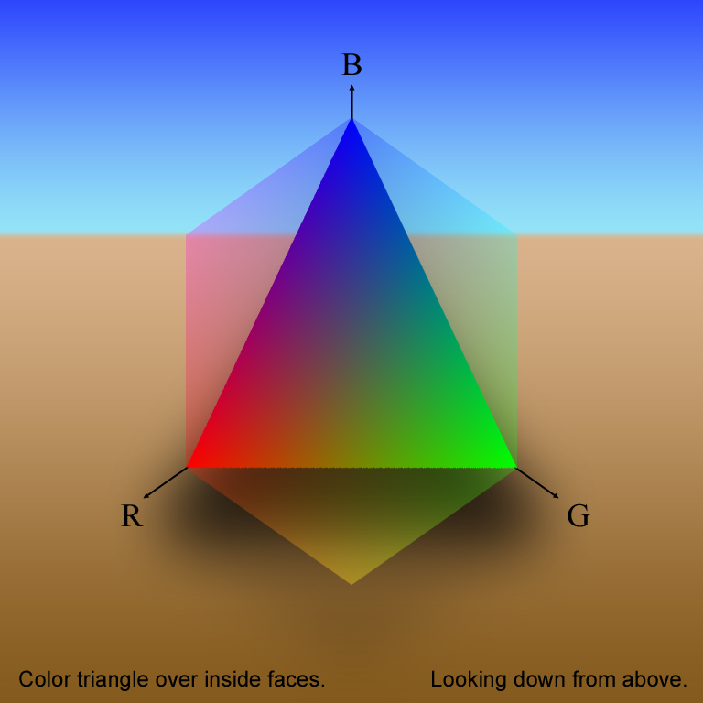
Color Cube: Equivalue Triangle

Slide 24
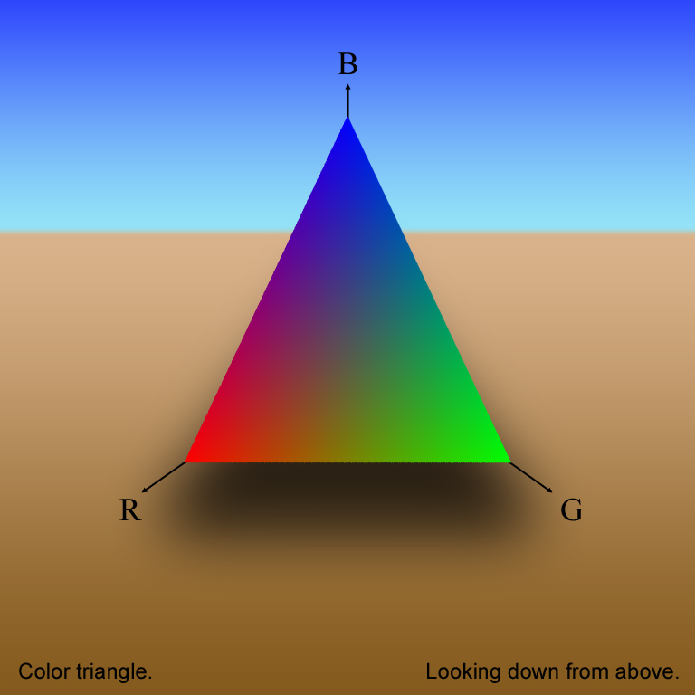
Color Cube: Equivalue Triangle
Every point on the equivalue plane has the same value. (“well, duh!”) There is one plane for each value (r+g+b)/3. The hue and saturation for all colors with the same value are calculated in the plane.

Slide 25
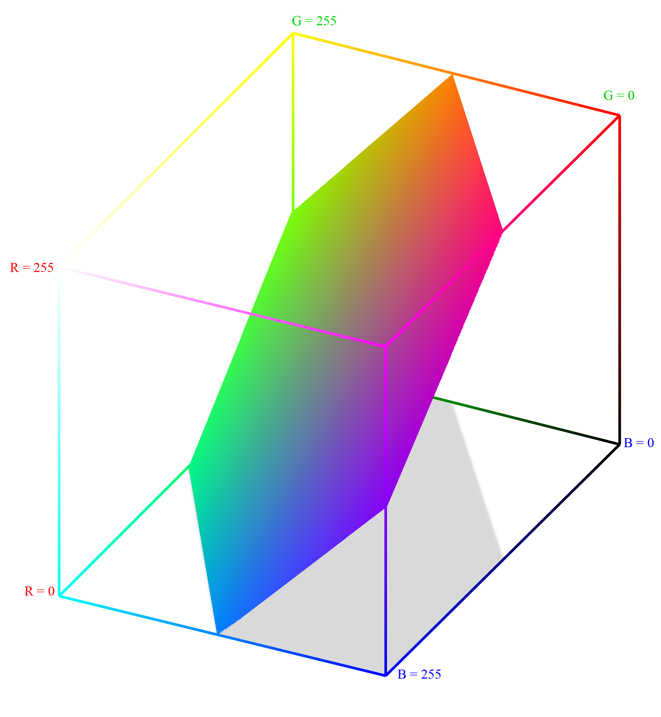
Equivalue Color Hexagon
A plane through the colors
forms a triangle inside the color cube if c ≤ 255 or c ≥ 510, or a hexagon if 255 < c < 510. Every color on the planar surface is such that r + g + b = c. Therefore its value is c/3. It is on this equivalue plane that hue and saturation are computed.
c=384, v=128

Slide 26
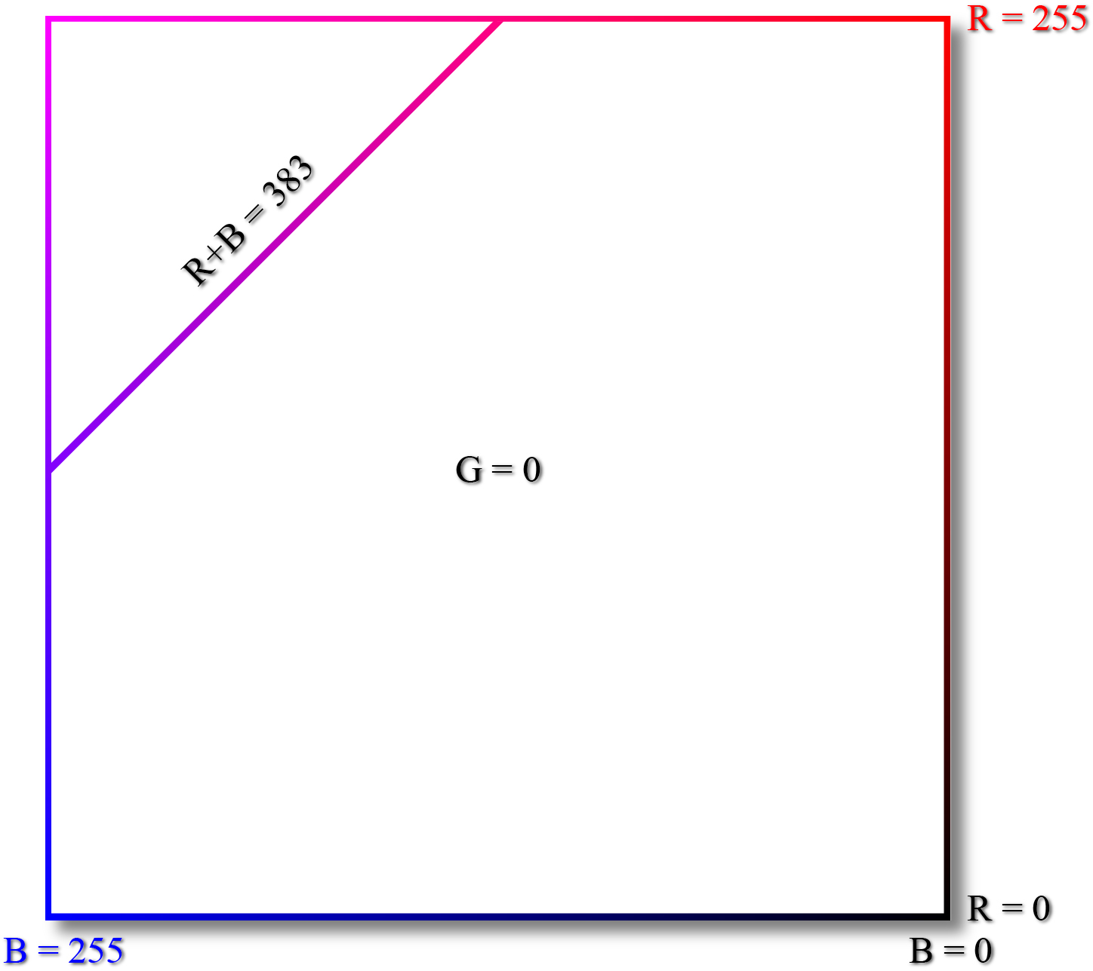
Equivalue Color Hexagon
Outside looking in.
c=383, v=128
On the g = 0 face of the cube the hexagon traces the line, r + b = 383.
Right Side

Slide 27
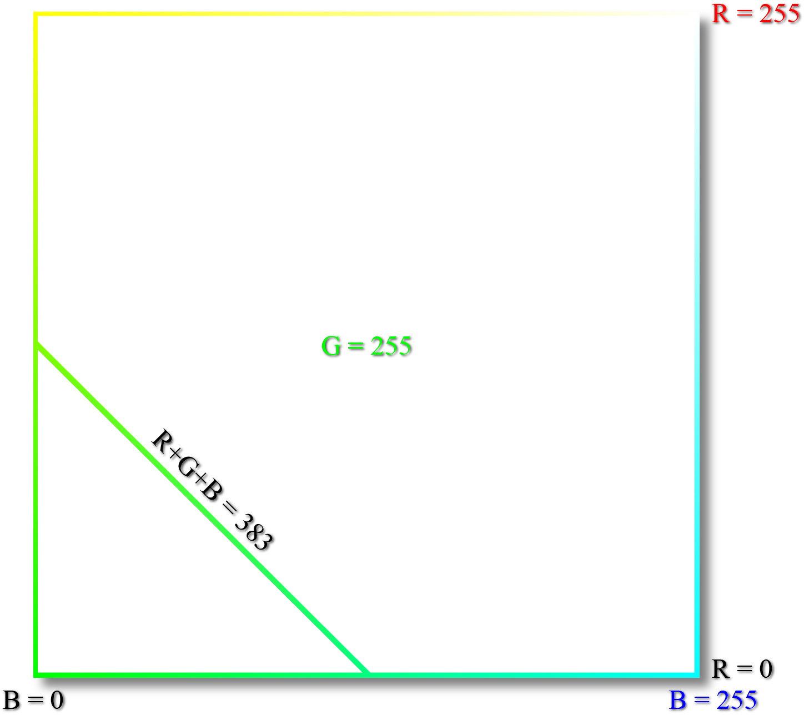
Equivalue Color Hexagon
Outside looking in.
c=383, v=128
On the g = 255 face of the cube the hexagon traces the line, r + b + g = 383.
Left Side

Slide 28
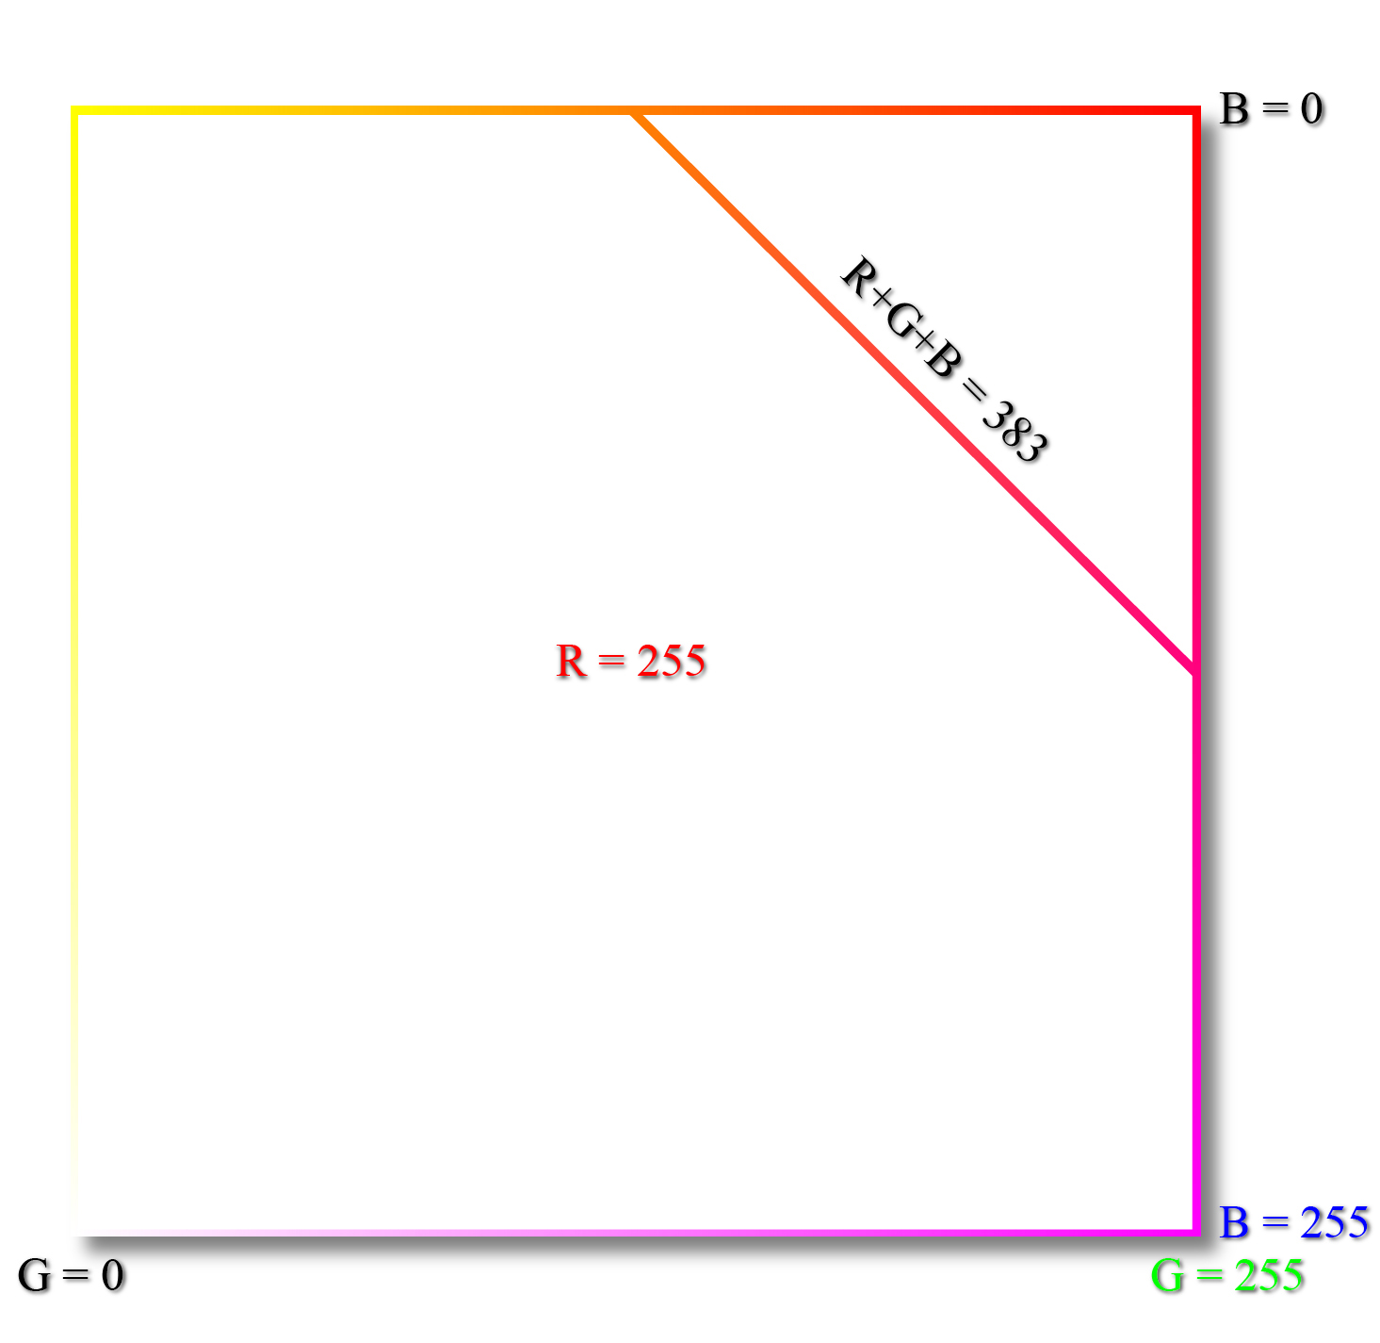
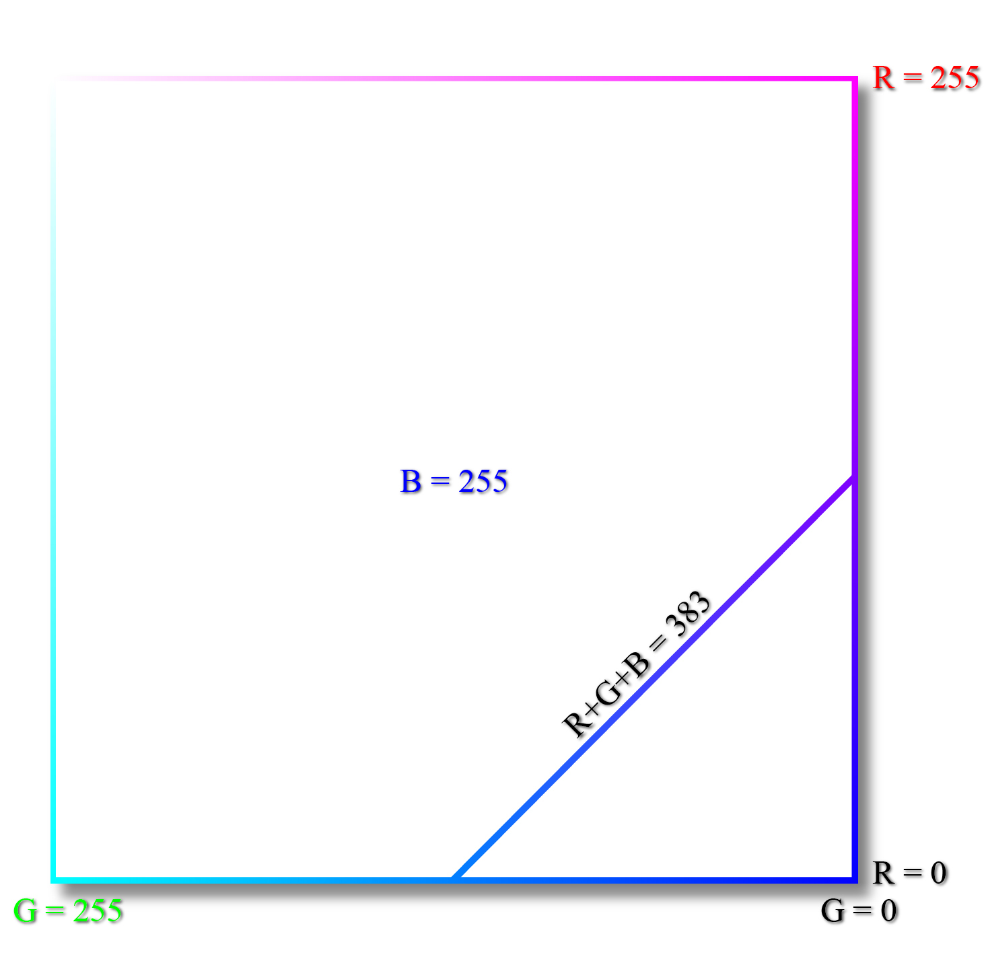
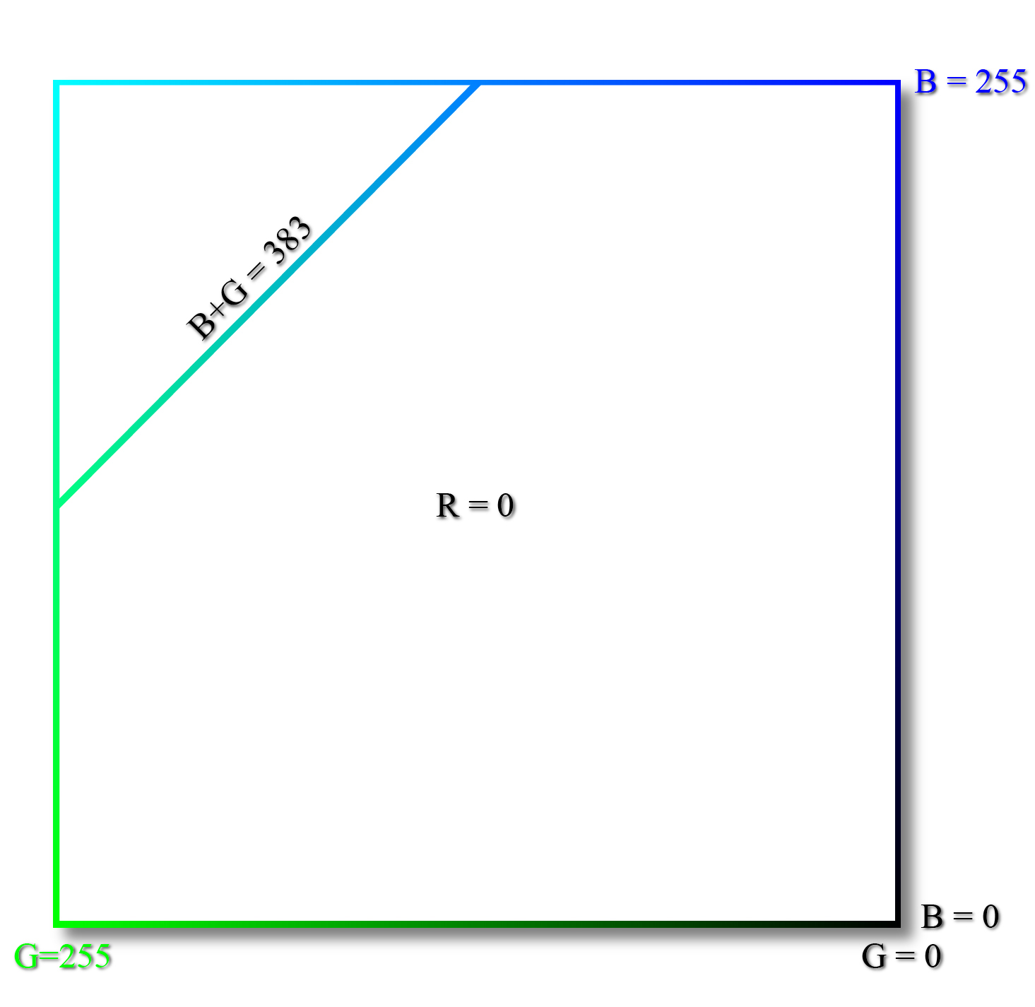
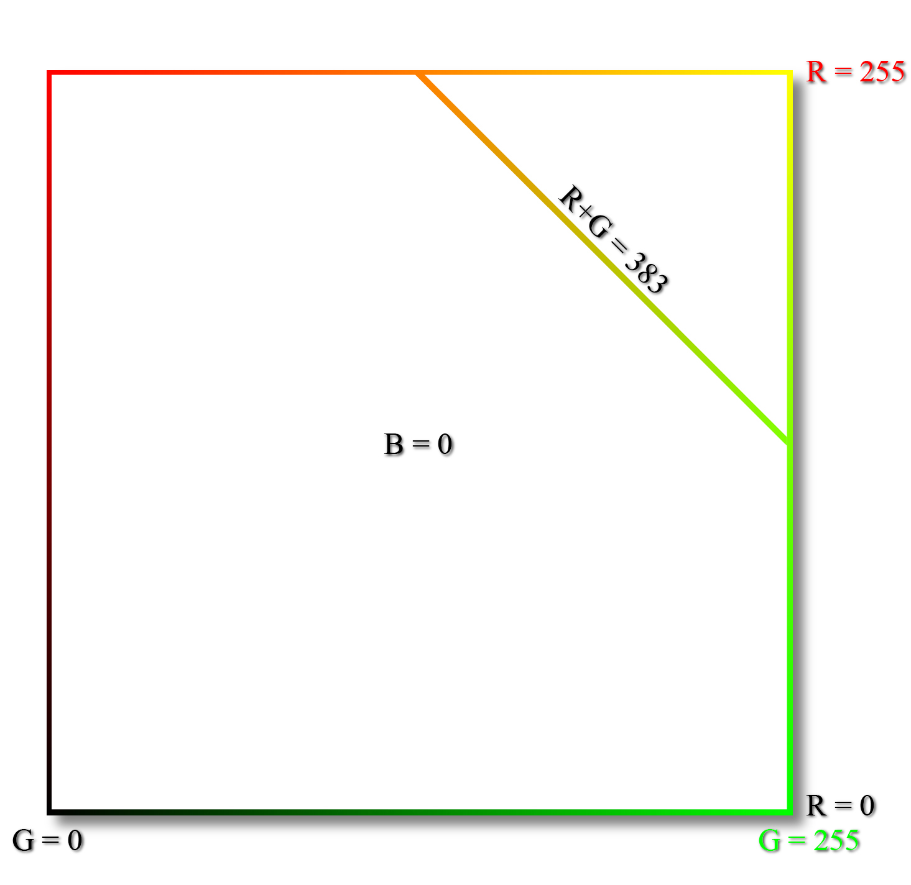
Equivalue Color Hexagon
Outside looking in.
Top
Front
The lines on the other four faces similarly have r + b + g = 383.
Bottom
Back

Slide 29
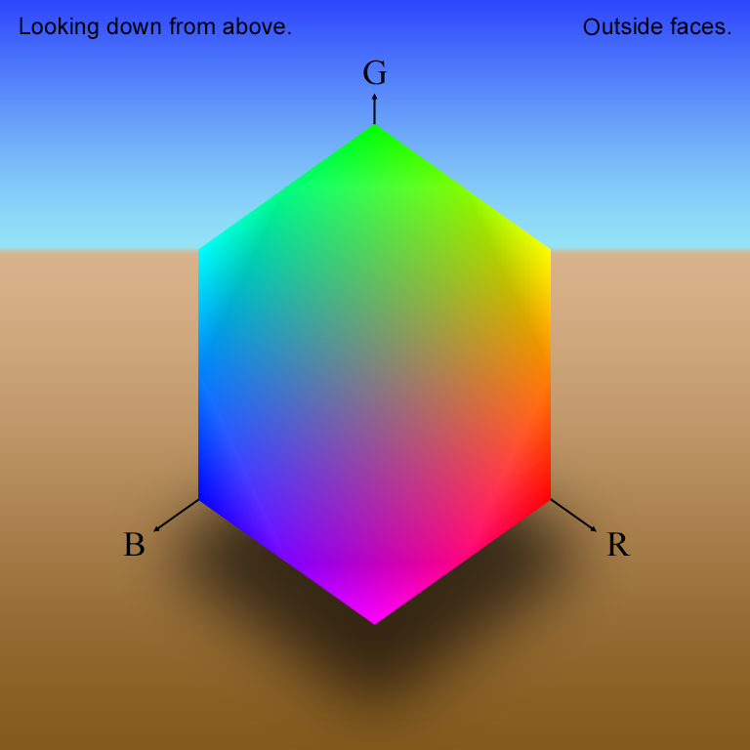
Color Cube: Equivalue Hexagon
Notice the outline of the hexagon. It is not there – not a real feature of the color surface. The planar discontinuities in 3D at the edges of the hexagon project to abrupt changes in the color gradient in the 2D image. The change in gradient is a second order effect that is exaggerated by the color-agonist, center-surround edge detectors on the retina. It is an optical illusion.

Slide 30
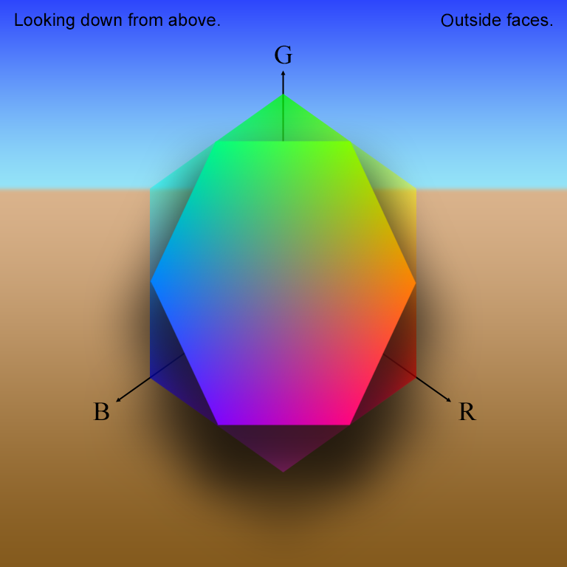
Color Cube: Equivalue Hexagon
As the cube is faded out over this and the next 2 slides, the discontinuity diminishes and the virtual outline disappears.

Slide 31
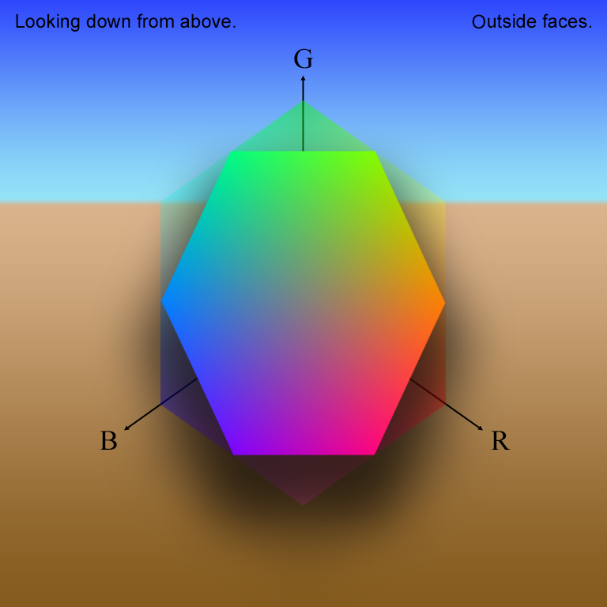
Color Cube: Equivalue Hexagon

Slide 32
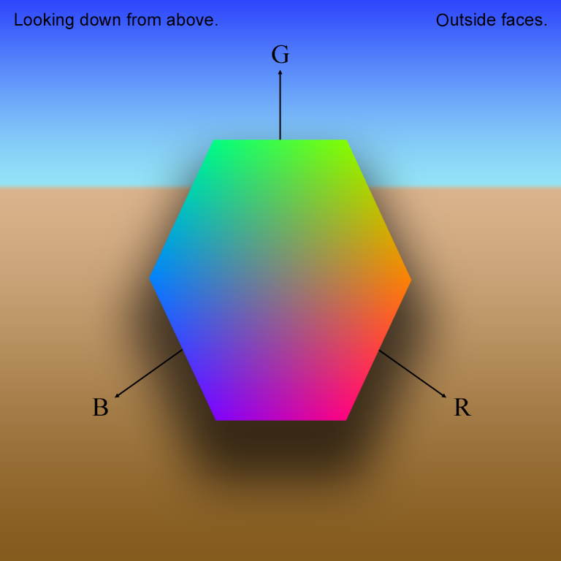
Color Cube: Equivalue Hexagon
Every point on the equivalue plane has the same value. (“well, duh!”) There is one plane for each value (r+g+b)/3. The hue and saturation for all colors with the same value are calculated in the plane.

Slide 33
Color Cube: Equivalue Hexagon

Slide 34
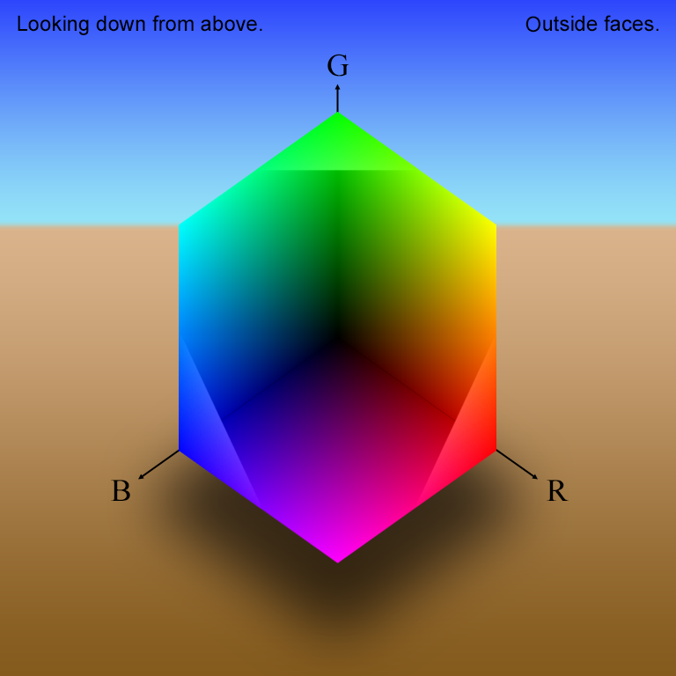
Color Cube: Equivalue Hexagon
Here the hexagon is cut out of the cube to provide another view.

Slide 35
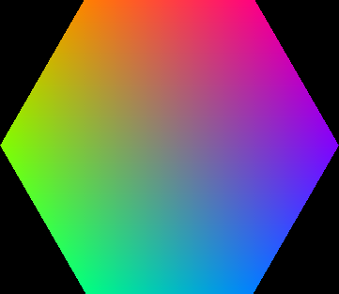



RGB Components of the Color Hexagon at Value 128
Red
r+g+b = 384
r∈{0,…,255}
g∈{0,…,255}
b∈{0,…,255}
Green
Blue

Slide 36
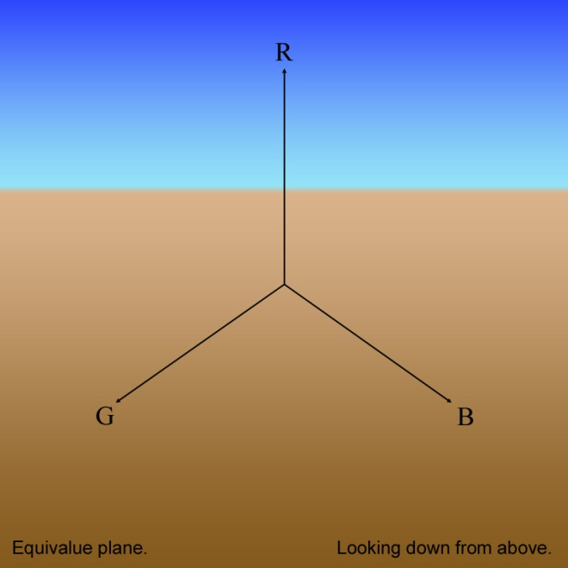
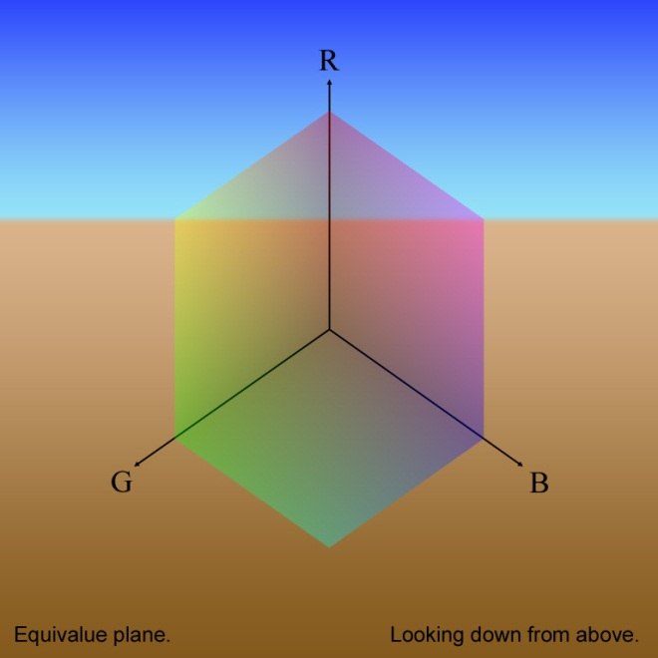
Equivalue Plane Intersecting Color Cube
Projection: the gray line is perpendicular to this page.
Equivalue plane at v = 0: single point, pure black.

Slide 37
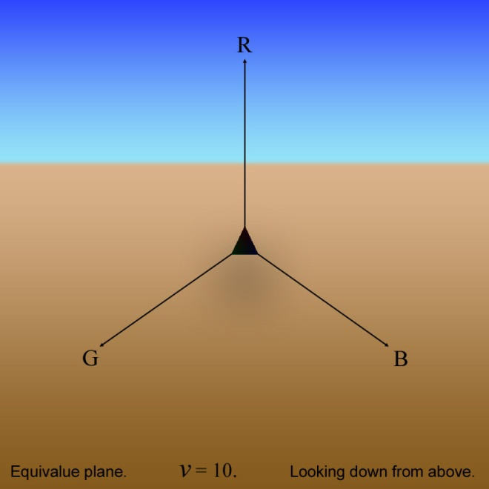
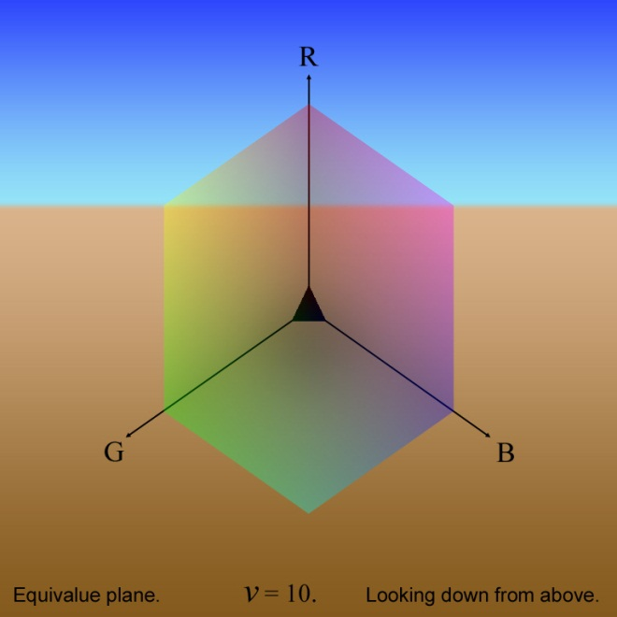
Equivalue Plane Intersecting Color Cube
Projection: the gray line is perpendicular to this page.

Slide 38
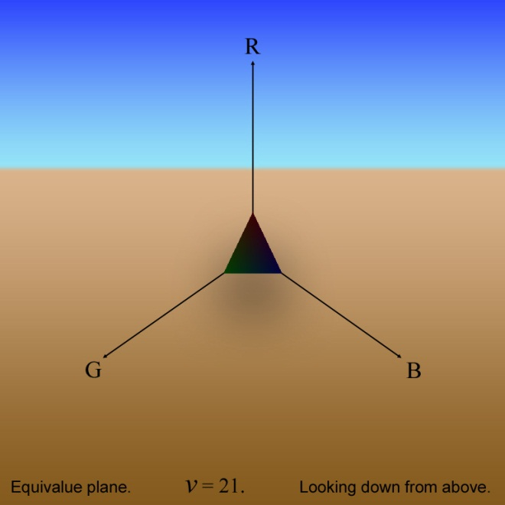
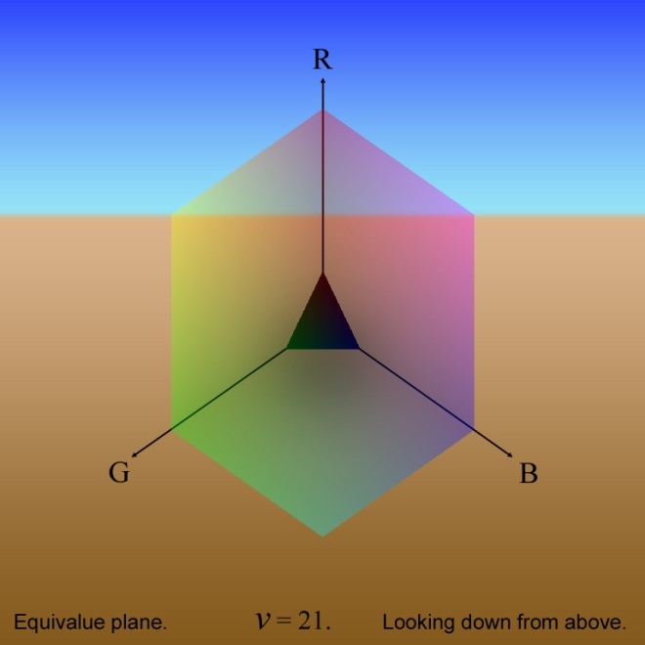
Equivalue Plane Intersecting Color Cube
Projection: the gray line is perpendicular to this page.

Slide 39
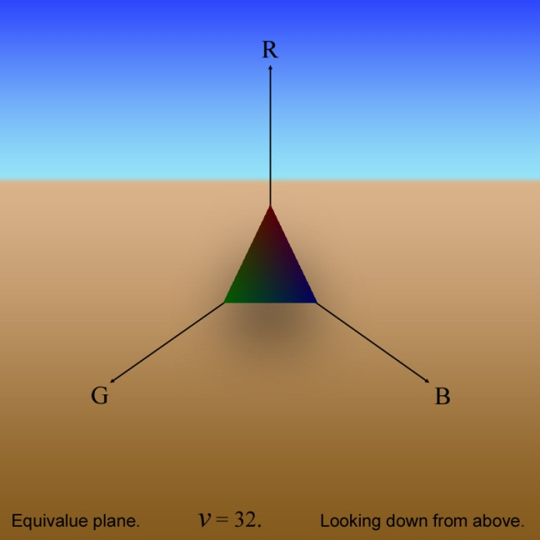
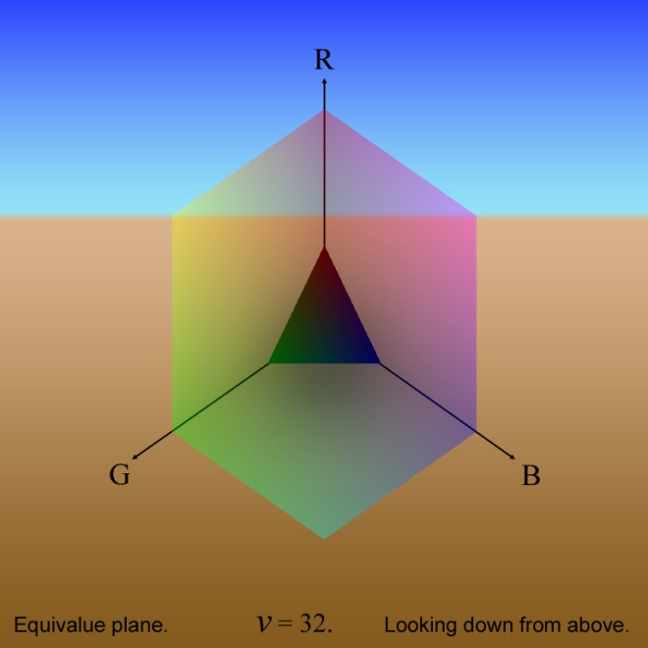
Equivalue Plane Intersecting Color Cube
Projection: the gray line is perpendicular to this page.

Slide 40
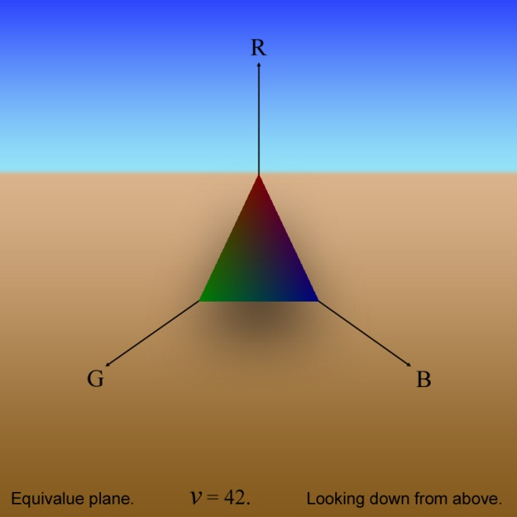
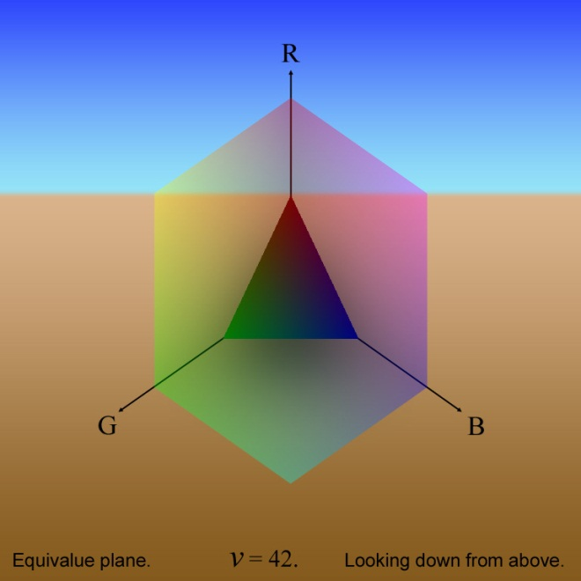
Equivalue Plane Intersecting Color Cube
Projection: the gray line is perpendicular to this page.

Slide 41
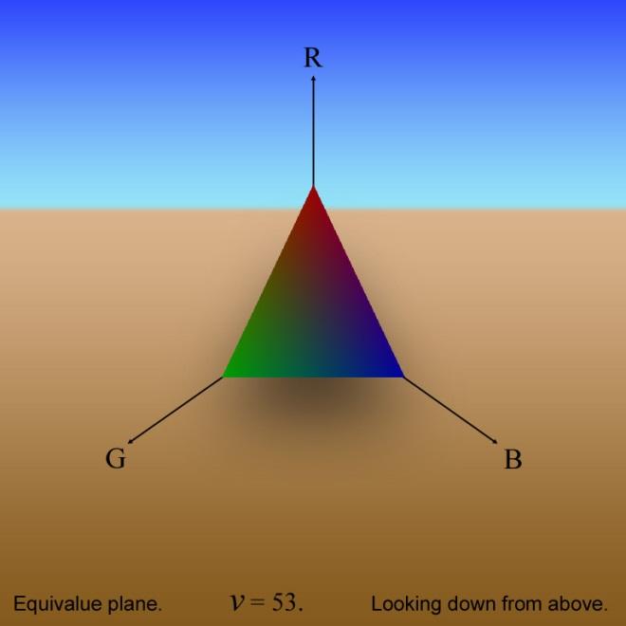
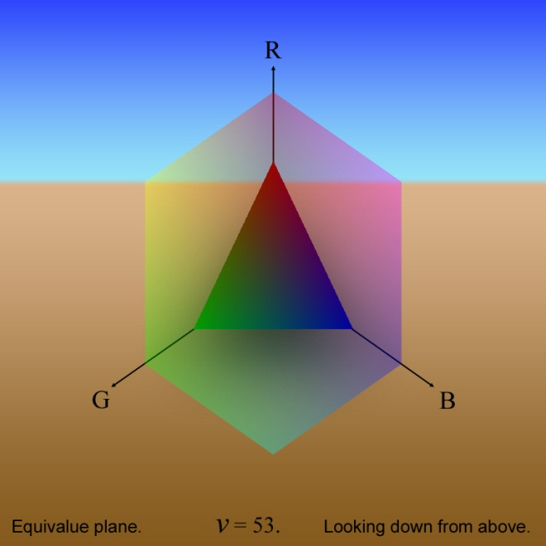
Equivalue Plane Intersecting Color Cube
Projection: the gray line is perpendicular to this page.

Slide 42
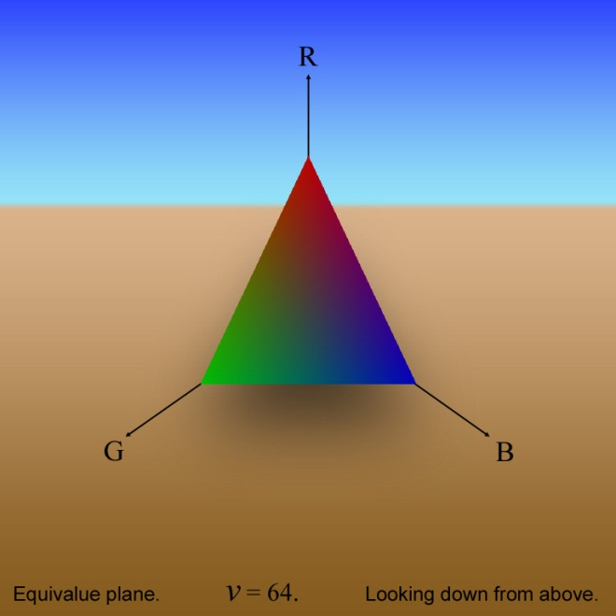

Equivalue Plane Intersecting Color Cube
Projection: the gray line is perpendicular to this page.

Slide 43


Equivalue Plane Intersecting Color Cube
Projection: the gray line is perpendicular to this page.

Slide 44


Equivalue Plane Intersecting Color Cube
Projection: the gray line is perpendicular to this page.
Equivalue plane at v = 85: largest upright triangle, start of hexagonal intersections.

Slide 45



Equivalue Plane Intersecting Color Cube
Projection: the gray line is perpendicular to this page.

Slide 46



Equivalue Plane Intersecting Color Cube
Projection: the gray line is perpendicular to this page.

Slide 47



Equivalue Plane Intersecting Color Cube
Projection: the gray line is perpendicular to this page.

Slide 48



Equivalue Plane Intersecting Color Cube
Projection: the gray line is perpendicular to this page.
Equivalue plane at v = 128: symmetric hexagon, intersecting plane with largest area.

Slide 49



Equivalue Plane Intersecting Color Cube
Projection: the gray line is perpendicular to this page.

Slide 50



Equivalue Plane Intersecting Color Cube
Projection: the gray line is perpendicular to this page.

Slide 51



Equivalue Plane Intersecting Color Cube
Projection: the gray line is perpendicular to this page.

Slide 52



Equivalue Plane Intersecting Color Cube
Projection: the gray line is perpendicular to this page.
Equivalue plane at v = 170: largest inverted triangle, end of hexagonal intersections.

Slide 53



Equivalue Plane Intersecting Color Cube
Projection: the gray line is perpendicular to this page.

Slide 54



Equivalue Plane Intersecting Color Cube
Projection: the gray line is perpendicular to this page.

Slide 55



Equivalue Plane Intersecting Color Cube
Projection: the gray line is perpendicular to this page.

Slide 56



Equivalue Plane Intersecting Color Cube
Projection: the gray line is perpendicular to this page.

Slide 57



Equivalue Plane Intersecting Color Cube
Projection: the gray line is perpendicular to this page.

Slide 58



Equivalue Plane Intersecting Color Cube
Projection: the gray line is perpendicular to this page.

Slide 59



Equivalue Plane Intersecting Color Cube
Projection: the gray line is perpendicular to this page.

Slide 60



Equivalue Plane Intersecting Color Cube
Projection: the gray line is perpendicular to this page.
Equivalue plane at v = 255: single point, pure white.

Slide 61



HSV Color Representation
+ marks the spot where R=G=B= (r0+g0+b0)/3
Color vector p0
p0 = (r0, g0, b0)
Triangle:
lies in plane R+G+B=(r₀+g₀+b₀),
intersects R, G, & B axes at r₀+g₀+b₀, and contains p₀.

Slide 62

A Color Point on its Equivalue Plane*
*where all the colors have components r, g, & b such that r+g+b = the same constant c.

Slide 63

The Color Vector Associated with the Color Point

Slide 64

The Vector’s Coordinates and RGB Component Vectors

Slide 65

The Color Cube, the Equivalue Plane, & the Gray Line*
*The point at which the gray line intersects equivalue plane is called the “gray point” .

Slide 66

The Color Point and the Gray Line*
*“+” marks the gray point on the equivalue plane.

Slide 67


The Saturation Component* of the Color Vector
*is a vector in the equivalue plane from the gray point to the color point; its length is the scalar saturation.

Slide 68
The Saturation and Value Components of the Color Vector

Slide 69

The Hue*, Saturation, and Value of the Color
*is the angle in the plane from the red line (in the plane from the gray point to the red axis) to the color point.

Slide 70

The Hue and the Saturation on the Equivalue Plane

Slide 71

The Hue, Saturation, and Value with the Gray Line

Slide 72



HSV Components of the Color Hexagon at Value 128
r+g+b = 384
h∈(π/128)×{0,…,255}
hue
s∈(1/255)×{0,…,255}
v = 128
s∈[0,1]
value
saturation

Slide 73

HSV Components of the Color Hexagon at Value 128
r+g+b = 384
h∈[0,2π)
hue
v = 128
s∈[0,1]
value
saturation

Slide 74
HSV Color Representation
+ marks the spot where R=G=B= (r0+g0+b0)/3
Color vector p0
p0 = (r0, g0, b0)
Triangle:
lies in plane R+G+B=(r₀+g₀+b₀),
intersects R, G, & B axes at r₀+g₀+b₀, and contains p₀.

Slide 75
RGB to HSV Conversion
x
v0 is the value vector.
v0
s0
p0
v0 is the value – a scalar.
96

Slide 76
RGB to HSV Conversion
… so there is ambiguity in the definition of v0. Its interpretation is contextual.
x
c/3 is the usual value-image intensity (the average of r, g, & b), …
v0
s0
p0
… c √3/3 is the length of the value vector,…
96

Slide 77
RGB to HSV Conversion
is the red line, x, for all colors with value, v0.
x
v0
s0
is the saturation vector, s0, for color p0.
p0
is the hue angle, h 0, for color p0.
88

Slide 78

RGB to HSV Conversion: The Red Line
Note that:
for c > 85, the red line (vector) x extends beyond the color cube, and
vector x = 0 if and only if c = 0.

Slide 79
RGB to HSV Conversion
In summary,
The value is the average of the r, g, & b intensities of the color.
x
where c = r0 + g0 + b0 , the sum of the components of p0.
v0
s0
p0
and
The scalar saturation, s0, is the length of the saturation vector, s0.
The dot product of (i) the unit vector in the saturation direction and (ii) the unit vector in the direction of the red line is the cosine of the hue.

Slide 80
Normalizing the Saturation
The scalar saturation,
x
usually is normalized to lie between 0 and 1. There are a number of possible ways to do this. One is to use the largest possible length of a saturation vector in the color cube. That vector lies in the triangle with vertices [r g b]^{T} = [255 0 0] ^{T}, [0 255 0] ^{T}, and [0 0 255] ^{T}. There are 3 such vectors, from the gray point to pure red, pure green, or pure blue. The red one is
v0
s0
p0
which has length
See other approaches to normalizing the saturation on slides nnn
Therefore, s0 can be replaced by .

Slide 81
Other Steps to Include in RGB→HSV
There are a few places in the algorithm where computation can be problematic. These include division by zero, exceeding limits due to round-off errors, and values returned by library functions that are inconsistent with the RGB→HSV algorithm.
Recall that the hue calculation for color, p, requires division by the product of the length of the red vector, x(p), and the length of the saturation vector, s(p). If either of these is 0, then the argument could be undefined. Matlab returns NaN for acos(0/0).
If, due to finite word-length effects, the dot product evaluates to a number with magnitude ever-so-slightly greater than one, the inverse cosine will return a complex value.
s is the zero vector whenever p is a gray level (all its components are equal). Vector x = 0 if and only if color p = 0. The workaround is to add 1 to the denominator at every pixel where either p = 0 or s = 0. Then set h = 0 at those same pixel locations. If h is complex, replace it with real(h).

Slide 82

Other Steps to Include in RGB→HSV
Inverse cosine routines, like Matlab’s acos, return angles in the range [0,π], whereas the RGB→HSV algorithm needs them to be in the range [0,2π).
Note that θ∈[0,π] if and only if b ≤ g in p and θ∈(-π,0) if and only if b > g. Therefore the workaround is to let:
where

Slide 83
RGB to HSV Algorithm 1
This algorithm is written in pseudocode, not Matlab.
A vector-geometric algorithm
Compute scalar value image, v, from RGB image, I=[r g b].
Compute vector value image, V = [v v v].
Compute vector saturation image, S = I - V.
Compute scalar saturation image, s = || S ||.
Compute red axis vector image, X = [2v –v –v].
Compute red axis scalar image, x = || X ||.
Create logical image, z(r,c) = (s(r,c)==0)|(x(r,c)==0).
Compute hue cosine image, c = (S•X)/((s⋅x)+z).
Compute hue angle image, h = cos⁻¹(c).
Create logical image, m(r,c) = b(r,c) > g(r,c).
Adjust h = ~m⋅h + m⋅(2pi-h).
Normalize the saturation s = s / 208.2066.
Return [h s v]^{T}.
110

Slide 84
RGB to HSV Algorithm 1
|| ⋅ || is the norm operator – the square root of the pixel-wise sum of the squares of the image’s 3-vector components.
A vector-geometric algorithm
Compute scalar value image, v, from RGB image, I=[r g b].
Compute vector value image, V = [v v v].
Compute vector saturation image, S = I - V.
Compute scalar saturation image, s = || S ||.
Compute red axis vector image, X = [2v –v –v]^{T}.
Compute red axis scalar image, x = || X ||.
Create logical image, z(r,c) = (s(r,c)==0)|(x(r,c)==0).
Compute hue cosine image, c = (S•X)/((s⋅x)+z).
Compute hue angle image, h = cos⁻¹(c).
Create logical image, m(r,c) = b(r,c) > g(r,c).
Adjust h = ~m⋅h + m⋅(2pi-h).
Normalize the saturation s = s / 208.2066.
Return [h s v]^{T}.
V =3-band val img
S•X is the pixel-wise dot product of images S & X. s⋅x is the p.w. scalar product of the scalar images s and x.
z and m are binary images z(r,c)==1 iff s(r,c)==0; m(r,c)==1 iff b(r,c) > g(r,c).
matlab: || S || = sqrt(sum(S.^2,3));

Slide 85
A Faster Hue Calculation
Project color p0 onto the red line, x, using the dot product,
Vector is perpendicular to x. Project p0 on to z to get
The ratio of the second dot product to the first is the tangent of the hue angle. Therefore,

Slide 86
RGB to HSV Algorithm 2
This algorithm is written in pseudocode, not Matlab.
A vector-geometric algorithm
Using the expressions on the previous slide reduces the number of variables and the number of computations necessary to compute the hue. Experiments with Matlab show Algorithm 2 to be 2.7 times faster than Algorithm 1. Both algorithms return the same values.
Compute scalar value image, v, from RGB image, I=[r g b]^{T}.
Compute vector value image, V = [v v v]^{T}.
Compute vector saturation image, S = I - V.
Compute scalar saturation image, s = || S ||.
Compute the scalar image, x = 2r–g–b.
Compute the scalar image, y = sqrt(3)(g-b).
Compute hue angle image, h = atan2(y,x).
Create a logical image, m(r,c) = b(r,c) > g(r,c).
Adjust h = ~m⋅h + m⋅(2pi+h).
Normalize s = s / 208.2066.
Return [h s v]^{T}.
atan2 returns angles in (-π,π). Negative angles are in the b>g region. They are shifted by adding them to 2π.
110

Slide 87




Example RGB Image and HSV Bands
Original image
Karen Gillis Taylor, “A Fruit Color Study.”
Hue image displayed with a primary color color-map
Saturation image scaled to (0,…,255)
Value Image

Slide 88

HSV to RGB Conversion
This conversion requires a change of coordinates through a rotation and a translation.
The equivalue plane is perpendicular to the value vector, v.
The plane contains vector x defined on slide 77.
Therefore, v is perpendicular to x and y = v × x is also in the plane.
If we keep the directions but ignore the magnitudes, the unit vectors
ˆ
ˆ
ˆ
form an orthonormal basis with respect to the equivalue plane.

Slide 89

HSV to RGB Conversion
Since the x- and y-axes lie in the equivalue plane and the cdt. origin is the gray point, we set v = 0 for now.
Given values h, s, and v, where
ˆ
ˆ
the saturation vector is
ˆ
with respect to unit vectors x, y, and v, in the equivalue plane.
ˆ
ˆ
ˆ

Slide 90
HSV to RGB Conversion
If s is in the range 0 to 1, then it must be denormalized first by multiplying by smax.
Given values h, s, and v, where
ˆ
These are the coordinates of s with respect to x, y, & v.
ˆ
the saturation vector is
ˆ
ˆ
ˆ
ˆ
with respect to unit vectors x, y, and v, in the equivalue plane.
ˆ
This is s written as a linear combination of vectors x, y, & v.
ˆ
ˆ
ˆ

Slide 91

HSV to RGB Conversion
x, y, and v, are not in the same directions as the red, green, and blue unit vectors, r, g, and b.
Therefore, [s]xyv , which we know, is not equal to [s]rgb , which we do not know, but need in order to find the color, p0, with respect to r, g, and b.
ˆ
ˆ
ˆ
ˆ
ˆ
ˆ
We need to find r0, g0, & b0…

Slide 92
HSV to RGB Conversion
… which means we need to find the x, y, & v unit vectors in terms of the r, g, & b unit vectors.
Vector s written as a linear combination of vectors, r, g, and b, and s written as a linear combination of vectors, x, y, and v both refer to the same point on the equivalue plane.
ˆ
ˆ
ˆ
The specific numbers in [s]rgb and in [s]xyv (that represent the point w.r.t. the two coordinate systems) are, however, different.
ˆ
ˆ
and
ˆ
but

Slide 93

HSV to RGB Conversion
We can find r0, g0, and b0, from h0, s0, and v0, if we know how the unit vectors x, y, and v, are expressed with respect to r, g, and b. That relationship is in the form of a rotation matrix, A, such that,
ˆ
ˆ
ˆ
ˆ
Then,
ˆ
ˆ
96

Slide 94

HSV to RGB Conversion
When written w.r.t the xyz coordinate system we have
ˆ
ˆ
ˆ
So that,
ˆ
ˆ
But that implies,
ˆ
The columns of the rotation matrix, A, are the x, y, & v unit vectors in rgb coordinates.

Slide 95

HSV to RGB Conversion
How to find the x, y, & z unit vectors in rgb coordinates:
ˆ
ˆ
v is the unit vector in the direction [1 1 1]^{T} when written w.r.t rgb coordinates.
ˆ
ˆ
ˆ
x is perpendicular to v and has equal g and b components.
ˆ
ˆ
ˆ
ˆ
ˆ
y is the cross product of v with x.
ˆ
ˆ
ˆ
ˆ

Slide 96
HSV to RGB Conversion
The x, y, & z unit vectors in rgb coordinates are the columns of the rotation matrix:
Therefore, the rotation matrix is
Substitute that into the 2nd equation on slide 93 to get:
v0
s0
p0
Finally, [s]rgb must be translated to the value vector to obtain the rgb color of p0:
where s0 = [s]rgb and [v]rgb= v0 as def ’d. on slide 75.

Slide 97
HSV to RGB Algorithm
A vector-geometric algorithm
This inverts the outputs of both Algorithm 1 and Algorithm 2.
Reshape R×C images h, s, and v into RC×1 column vectors.
Denormalize the saturation image, s = 208.2066⋅s.
Compute the x-coordinate image, x = s⋅cos(h).
Compute the y-coordinate image, y = s⋅sin(h).
Construct the value vector image, V = [v v v]^{T}
Construct the 1st two columns of rotation matrix A
Rotate the saturation image S = [s1 s2 s3]^{T} = A[x y]^{T}.
Add the result to V to recover IRGB = S + V.
Round IRGB, convert it to uint8, and reshape it to R×C×3.
Note: if size(X) == [R C B], then size(X(:)) == [R⋅C⋅B 1].
Note: V is 3xRC, since v is an RCx1 column vector and V = [v v v]^{T}.
A3x2 multiplies [x y]^{T} which is 2xRC.
Lines 7 & 8: S, V, and IRGB are 3xRC.

Slide 98
Alternative HSV Representations
The HSV algorithms presented in the first part of this lecture are direct implementations of the vector math.
One of the problems with the direct approach is that it is that the presence of transcendental functions increases the time necessary to convert an image.
To use HSV at video frame rate requires a simpler algorithm that yields a reasonable approximation to the direct implementation.
v=(r+g+b)/3.
V = [v v v]^{T}.
S = I - V.
s = || S ||.
X = [2v –v –v]^{T}.
x = || X ||.
z(r,c) = … (s(r,c)==0)|(x(r,c)==0).
c = (S•X)/((s⋅x)+z).
h = cos⁻¹(c).
m(r,c) = b(r,c) > g(r,c).
h = ~m⋅h + m⋅(2pi-h).
s = s / 208.2066.
Return [h s v]^{T}.

Slide 99



Hexagonal Projection Representations
Faster algorithms use a hexagonal projection of the color cube. To generate the hexagon, rotate the color cube in 3-space then project it along its gray line (the diagonal from white to black) onto a chromaticity plane. The result is a hexagon that has the 6 primary colors – red, yellow, green, cyan, blue, and magenta – at its vertices.
rgb color vector, p, is projected on the hexagon where its hue and saturation are computed.

Slide 100



Hexagonal Projection Representations
Faster algorithms use a hexagonal projection of the color cube. To generate the hexagon, rotate the color cube in 3-space then project it along its gray line (the diagonal from white to black) onto a chromaticity plane. The result is a hexagon that has the 6 primary colors – red, yellow, green, cyan, blue, and magenta – at its vertices.
rgb color vector, p, is projected on the hexagon where its hue and saturation are computed.

Slide 101
A Fast RGB to HSV Algorithm
This algorithm is based on the hex projection.
Given color p0 = [R G B]^{T} where R, G, B ∈{0,…,255}, to compute [h s v]^{T} where s, v ∈[0,1] and h ∈[0,360) the algorithm proceeds as follows:
Compute [r g b] = [R G B]/255.
Set m = min(r,g,b) , M = max(r,g,b).
Set v = M.
Compute C = M – m.
If C == 0 then s=0, h=0. Return [h s v]^{T}.
s = C/M.
If M==r then h = ((g-b)/c) modulo 6.
else if M==g then h = 2 + (b-r)/c.
else h = 4 + (r-g)/c.
h = 60h.
R,G,B are numbers here not images.
Experiments with Matlab show this algorithm to be 3 times faster than Algorithm 1 and 1.13 faster than Algorithm 2. The numbers output by this one differ from the other two.
Reference: HSL and HSV - Wikipedia, the free encyclopedia
111

Slide 102
A Fast HSV to RGB Algorithm
This algorithm is the inverse of the previous one.
Given vector h0^{T} = [h s v] where h ∈ [0, 360), s ∈ [0, 1], and v ∈ [0, 1], to compute p0^{T} = [r g b] where r, g, b ∈ {0, …, 255}:
H = h/60.
C = v⋅s.
D = v-C.
X = C⋅(1 - |(H mod 2)-1|).
if 0 ≤ H < 1 then [r g b] = [C X 0]
else if 1 ≤ H < 2 then [r g b] = [X C 0]
else if 2 ≤ H < 3 then [r g b] = [0 C X]
else if 3 ≤ H < 4 then [r g b] = [0 X C]
else if 4 ≤ H < 5 then [r g b] = [X 0 C]
else if 5 ≤ H < 6 then [r g b] = [C 0 X]
else [r g b] = [0 0 0]
[r g b] = 255*[r+D g+D b+D]
h, s, & v are numbers here not images.
Reference: HSL and HSV - Wikipedia, the free encyclopedia
109

Slide 103


Comparison of the Two Algorithms
x
v0
s0
p0
Projection of the color on the choma-hexagon.
Geometric representation on the equivalue plane

Slide 104
Geometric Hexagonal Projection
Given a color, its value is the projection, parallel to the hexagon, of the rgb point onto the gray line scaled by .
Its hue is the angular distance around the hexagon from the projection of the red axis to the color, projected parallel to the gray line.
The saturation is the ratio of the distance from the gray line to the projected color, [0,p0], to the distance from the gray line to one of the vertices of the hexagon.
To compute the projection of a color we must find the rotation matrix for the cube.
Reference: HSL and HSV - Wikipedia, the free encyclopedia

Slide 105

Rotation of the Color Cube
Rotations for projection onto the hexagon:
Original cube viewed along the green axis.
Rotated 45° around the green axis.
Rotated cube viewed along the red axis.
Rotated 35.26° around the red axis.
Final pose viewed along the green axis.
(a)
(b)
(c)
(e)
(d)

Slide 106
Rotation of the Color Cube
Here’s the math.
Rotation matrix:
Cube corners:
Rotated cube corners:
Projected, rotated cube corners:
110

Slide 107
Rotation of the Color Cube
Here’s the math.
Rotation matrix:
45° around green
35.26° around red
Cube corners:
6 primaries + black and white
Rotated cube corners:
Now the 3rd dimension is along the gray line.
Projected, rotated cube corners:
Projection: set 3rd dim to 0.

Slide 108

Rotation and Projection of the Color Cube
y
The origin of this rectangular coordinate system is at the gray point in the center of the hexagon. The y-axis is vertical through the green point; the x-axis is to the right through orange.
x
Chromaticity-plane hexagon with red, yellow, green, cyan, blue, and magenta vertices.

Slide 109
Rotation and Projection of the Color Cube
The green axis of the hexagon remains aligned with the green axis of the original color cube, …
y
The origin of this rectangular coordinate system is at the gray point in the center of the hexagon. The y-axis is vertical through the green point; the x-axis is to the right through orange.
x
… but the red and blue axes project 60° on either side of green.
Chromaticity-plane hexagon with red, yellow, green, cyan, blue, and magenta vertices.

Slide 110

Geometric Hexagonal Projection
Use color p0 = [128 50 206]^{T} as an example. Rotating p0 with the matrix on slide 106 yields
The red axis is -30° from the hexagon’s x-axis and p0’s blue component is larger than its green. Therefore,
So we get (h,s,v) = (270°, 0.5298, 128) which is exactly what we got from the geometric algorithms (slides 83 & 86).
color projection onto the hexagon

Slide 111

Fast Algorithm for RGB to HSV
The fast algorithm on slide 100 uses the hex projection without rotating the color. First the RGB values are normalized by dividing them by the maximum intensity. The test color then scales to
The value of the color is taken to be simply the maximum of the normalized rgb values. Therefore v0 = 0.8078, whereas the geometric algorithm, if normalized would have yielded v0 = 0.5.
color projection onto the hexagon

Slide 112

Fast Algorithm for RGB to HSV
To project the color onto the hexagon the fast algorithm subtracts the minimum of the rgb intensities from all three. The reasoning is:
Let p0′ = p0 ± mv for v, the unit vector in the direction of the gray line and m a real number. The value of m shifts p0 up or down in the direction of the gray line. The result projects to the same point, p0^{proj}, in the hexagon independent of the value of m.
If m is min(r,g,b), then the color is shifted to one of the faces of the original color cube.
v = [1 1 1]^{T}
color projection onto the hexagon

Slide 113

Fast Algorithm for RGB to HSV
For our test color,
Subtract m from p0 to get
which is in the BR-plane of the color cube, since G = 0. (See slide 100.) Note that p0′ projects to the same point on the hexagon as does p0.
color projection onto the hexagon

Slide 114

Fast Algorithm for RGB to HSV
Define the chroma as C = M – m. This definition is justified by noting that
Chroma C = 0 for any color on the gray line
any color with two zero components is a primary,
for any color with one zero component the formula makes C equal the maximum of the two nonzero values.
Hue is defined with respect to chroma as
color projection onto the hexagon

Slide 115

Fast Algorithm for RGB to HSV
So, for
We get
which is exactly the hue from the geometric algorithms.
color projection onto the hexagon

Slide 116

Fast Algorithm for RGB to HSV
Value is defined as either
Saturation is defined with respect to chroma and value as
color projection onto the hexagon

Slide 117
Fast Algorithm for RGB to HSV
Therefore with the color p0 we have
Saturation is defined with respect to chroma and value as

Slide 118

Hue and Saturation via Projection onto the Hexagon
For color p0 = [128 50 206]^{T} we have three different HSV triples,
by vector math,
by the first hexagon projection,
and by the second hexagon projection,

Slide 119



Example RGB Image and HSV Bands
Fast Algorithm
Original image
Karen Gillis Taylor, “A Fruit Color Study.”
Hue image displayed with a primary color color-map
Saturation image scaled to (0,…,255)
Value Image

Slide 120
Example RGB Image and HSV Bands
Algorithms 1 & 2
Original image
Karen Gillis Taylor, “A Fruit Color Study.”
Hue image displayed with a primary color color-map
Saturation image scaled to (0,…,255)
Value Image

Slide 121

Maxwell’s Triangle
Probably the first attempts to produce color curves describing the trichromatic theory of color were those by Maxwell (1857, 1860).… [The] first chromaticity diagram was a circle devised by Newton. Later, Maxwell used an equilateral triangle.… In his trichromatic theory, each of the three primary colors—red, green, and blue—is located at a corner of the triangle. The white color is in the middle. Other colors are formed by a combination of the r, g, b components depending on the distances from each of the three sides of the triangle. This triangular representation has been used often with several modifications.
D. Malacara-Hernandez, Color Vision and Colorimetry: Theory and Applications, SPIE Press, (2002).

Slide 122

Brightness + Chrominance Representation
There are many different ways to encode color in terms of 1D brightness and 2D chrominance. Chrominance is often represented in terms of hue and saturation. A given brightness measure (e.g. value or NTSC luminance) defines a planar surface in the color cube on which the brightness is constant. One point on that surface is gray. The saturation of any color with the given brightness is defined as the distance on the plane from the color to the gray point. The hue is defined as the angular deviation from red measured in the same plane.

Slide 123
Brightness + Chrominance Representation
The HSV encoding scheme presented in the first part of this lecture is a direct implementation of the vector math. Although it is nonstandard, it demonstrates the ideas that underlie most of these representations.
For a good explanation of more standard HSV and LHS representations please see:
HSL and HSV - Wikipedia, the free encyclopedia.
An explanation of the hexagonal representation of HSV is given later in this lecture.

Slide 124

C.I.E. 1931 Color Space
This is not a simple slice through the color cube. It is a continuous mapping from the 3D cube onto a 2D plane that warps the color distribution.
Commission Internationale de l’Éclairage Uniform Color Scale
“The CIE system characterizes colors by a luminance parameter Y and two color coordinates x and y which specify the point on the chroma-ticity diagram. This system['s] ... parameters are based on the spectral power distribution ... of the light emitted from a colored object and are factored by sensitivity curves which have been measured for the human eye.”¹
¹http://hyperphysics.phy-astr.gsu.edu/hbase/vision/cie.html

Slide 125

C.I.E. 1931
This 1931 chromaticity diagram shows a single xy plane in the xyY color space.
“The CIE 1931 color space chromaticity diagram rendered in terms of the colors of lower saturation and value than those displayed in the diagram above that can be produced by pigments, such as those used in printing. The color names are from the Munsell color system.”^{2,3}
²https://en.wikipedia.org/wiki/CIE_1931_color_space
³https://en.wikipedia.org/wiki/Munsell_color_system
127

Slide 126

C.I.E. 1976 U.C.S.
This diagram, produced by the C.I.E. in 1976 specifies the range of colors perceptible at a single luminance, L′, by an average person. On the periphery the colors are monochromatic colors labeled with the corresponding wave-lengths of light. The white point is intersected by a curve that displays the corresponding black body temperature. (u′, v′) are the CIE chromaticity coordinates. The distance between points is related to the perceptual difference in color.
(L′, u′, v′) color space
http://hyperphysics.phy-astr.gsu.edu/hbase/vision/cie1976.html

Slide 127

C.I.E. 1976 U.C.S.
Color regions on a slightly desaturated CIE 1976 L′u′v′ color space similar to those on the CIE 1931 xyY digram on slide 125.
Point c0 on the line between colors c1 and c1 is the color that would be obtained by mixing the two endpoint colors in proportion to the distances from the endpoints. E.g.
where 0 ≤α≤ 1.
(L′, u′, v′) color space regions
http://hyperphysics.phy-astr.gsu.edu/hbase/vision/cie1976.html

Slide 128



Color Gamuts
A color gamut is the range of colors that can be represented by a given display. The pure R, G, and B values are plotted on a CIE chromaticity diagram. The colors inside the triangle are the ones that can be displayed by the device.

Slide 129

Color Gamuts
Since the display you are looking at is probably sRGB …
①
④
…and all the colors outside the triangle cannot be displayed …
②
…the colors you see in the CIE diagram are actually …
…inside this triangle …
③
… even though you could see them on a better display (like reality!)
⑤

